Slide 1
NASA Rotor67 流场分析

Slide 2
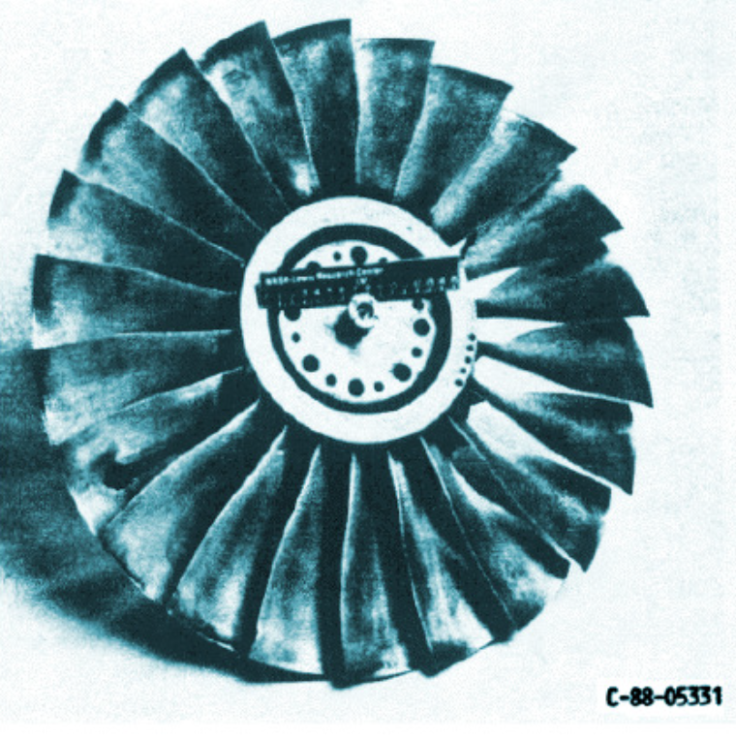
NASA Rotor 67 介绍
设计转速 16,043 rpm
叶尖线速度 429 m/sec
叶尖相对马赫数 1.38
设计压比 1.63
设计流量 33.25kg/sec
叶片数 22
参考文献
Strazisar et al. 1989
Strazisar et al. 2004

Slide 3
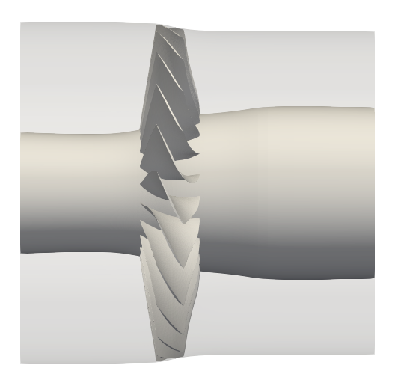
几何和关键尺寸
z_{in}=-18cm
z₀=0cm
z_{out}=35.5cm
大致尺寸
转子直径约 50cm；
叶片弦长约 10cm；
叶顶间隙约1mm。
轴向尺寸
叶根前缘点为: z₀=0cm;
计算域进出口: z_{in}=-18cm, z_{out}=35.5cm;
轮毂旋转部分: z=[-1.374cm,9.365cm];
流场测点: z₁=-2.472cm,z₂=11.001cm;
压气机特性线的试验测量值和计算值 基于z₁/z₂两个位置截面上的质量平均 积分值获得。
z₁=-2.472cm
z₂=11.011cm

Slide 4
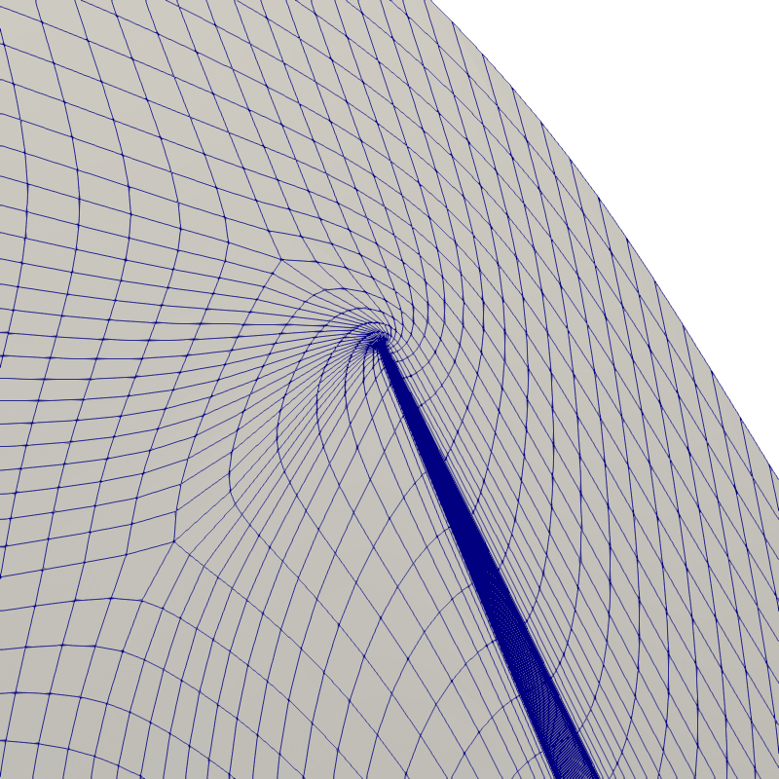
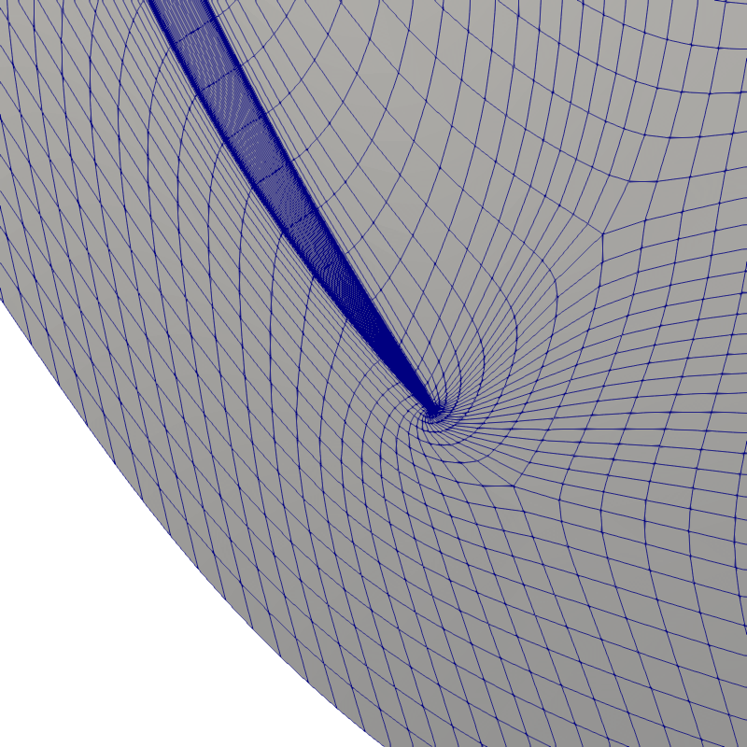
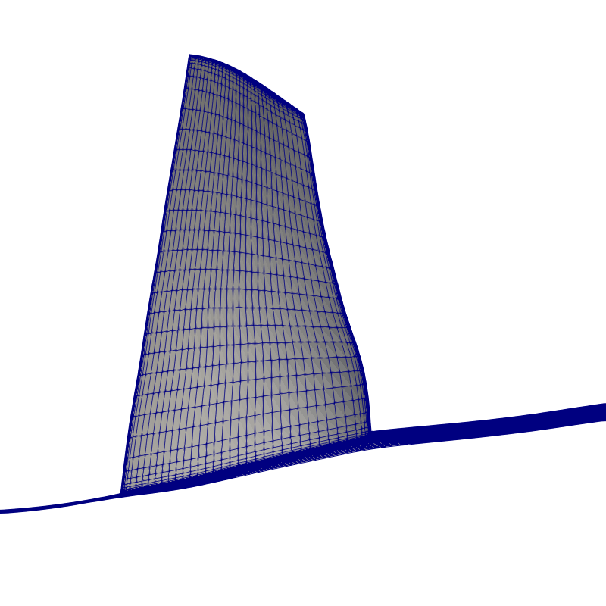
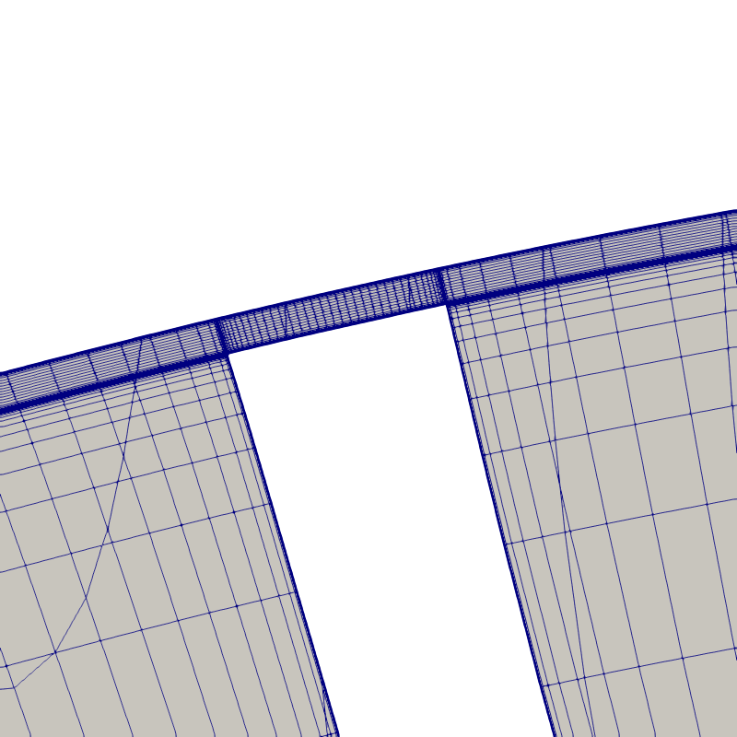
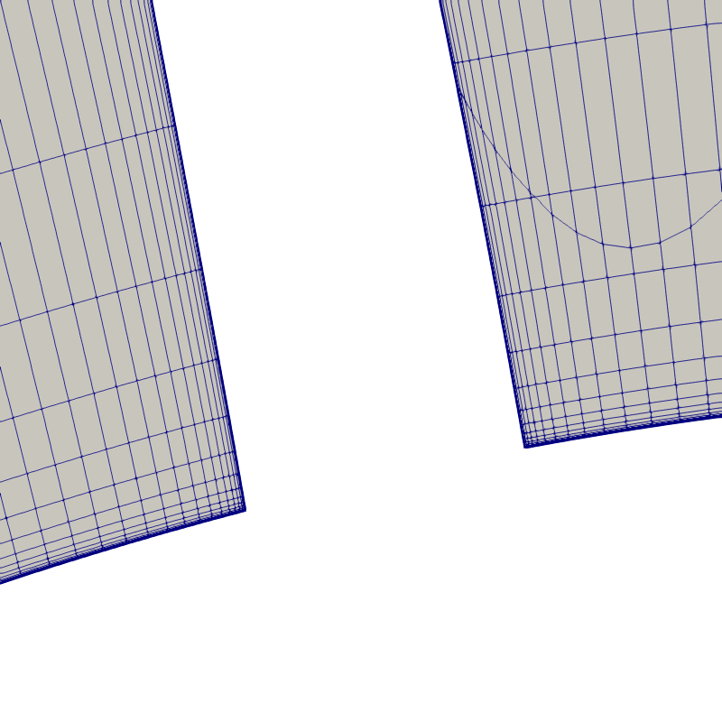
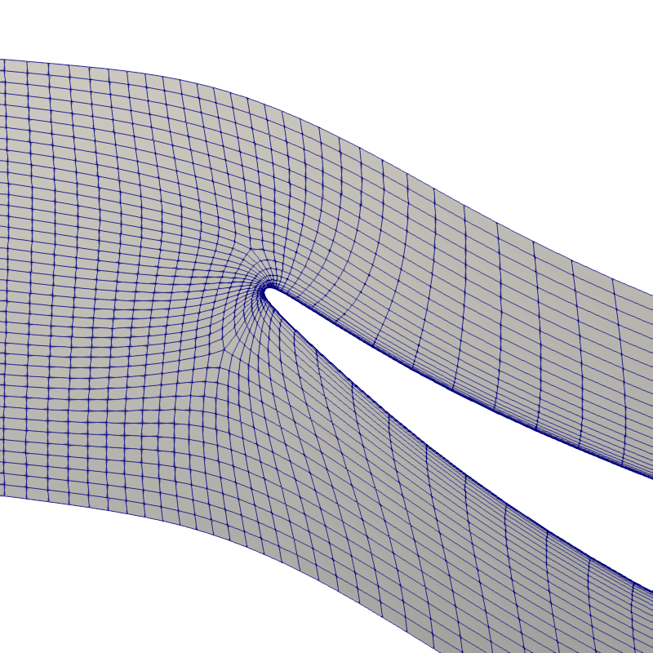
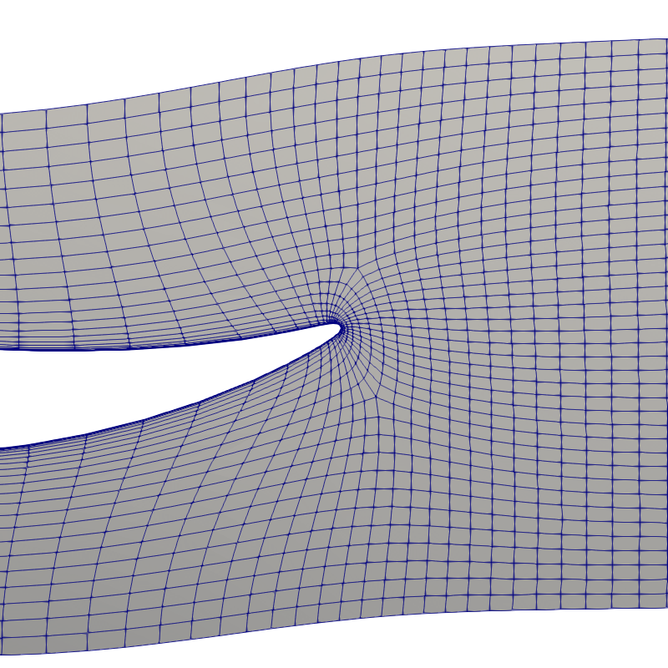
计算网格
粗网格
叶片前缘(机匣)
叶片尾缘(机匣)
叶根、轮毂角区
(约50%弦长处)
叶顶间隙
(约50%弦长处)
叶片前缘(轮毂)
叶片尾缘(轮毂)

Slide 5
叶片前缘(机匣)
叶片尾缘(机匣)
叶根、轮毂角区
(约50%弦长处)
叶顶间隙
(约50%弦长处)
叶片前缘(轮毂)
叶片尾缘(轮毂)

Slide 6
网格生成细节
总共粗、中、细三套网格，基本遵守各向均匀加密的原则
网格生成软件
NUMECA Autogrid 11.2（网格生成后可输出为Fluent网格）
网格拓扑
默认拓扑， Matching periodicity, normal/normal for high stagger
关键参数
网格 | 网格点 总数* | 壁面网格 高度(m) | 壁面网格 增长率 | 径向网格 点数 | 间隙网格 点数 | Max. skewness | Max. AR
粗 | 594,617 | 10⁻⁶ | 1.34 | 89 | 33 | 19.5 | 38358
中 | 1,011457 | 10⁻⁶ | 1.34 | 109 | 33 | 20.5 | 41062
细 | 2,038,685 | 10⁻⁶ | 1.27 | 137 | 33 | 20 | 29957
*这是转化为非结构网格之后的网格点总数，较Autogrid屏幕输出输出值略小

Slide 7
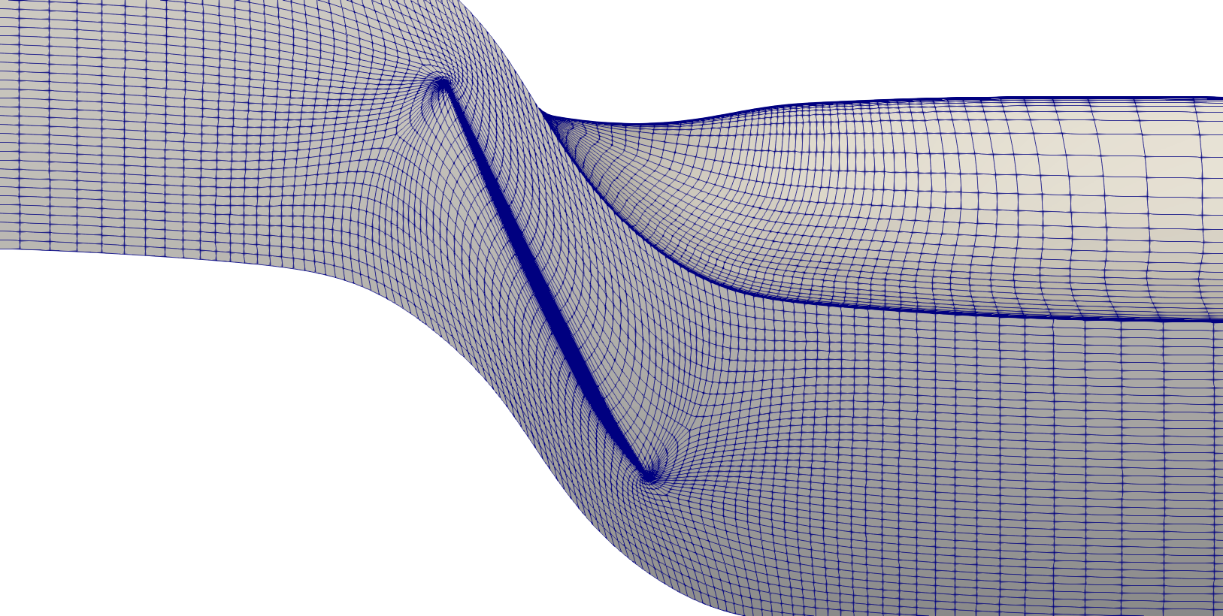
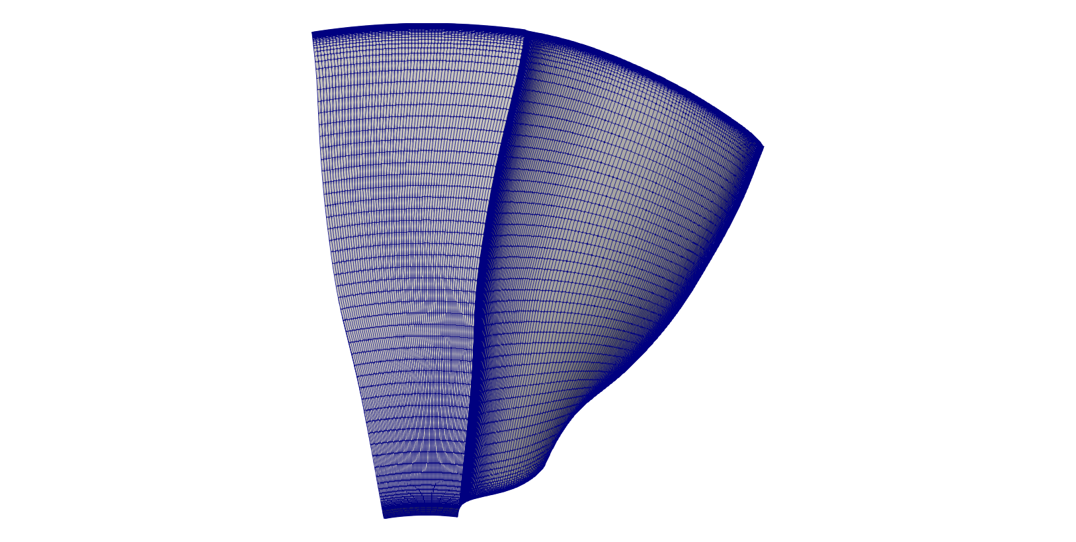

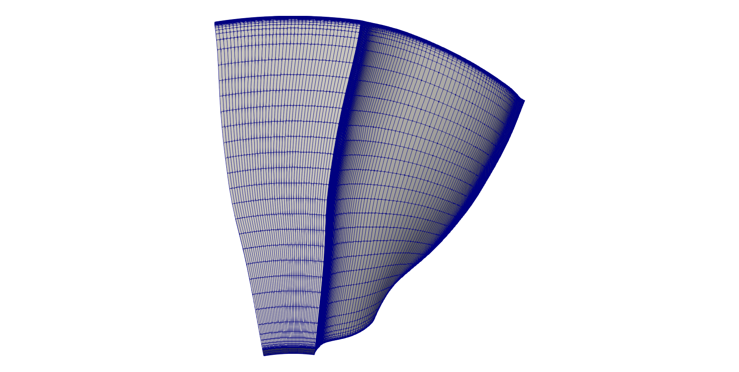
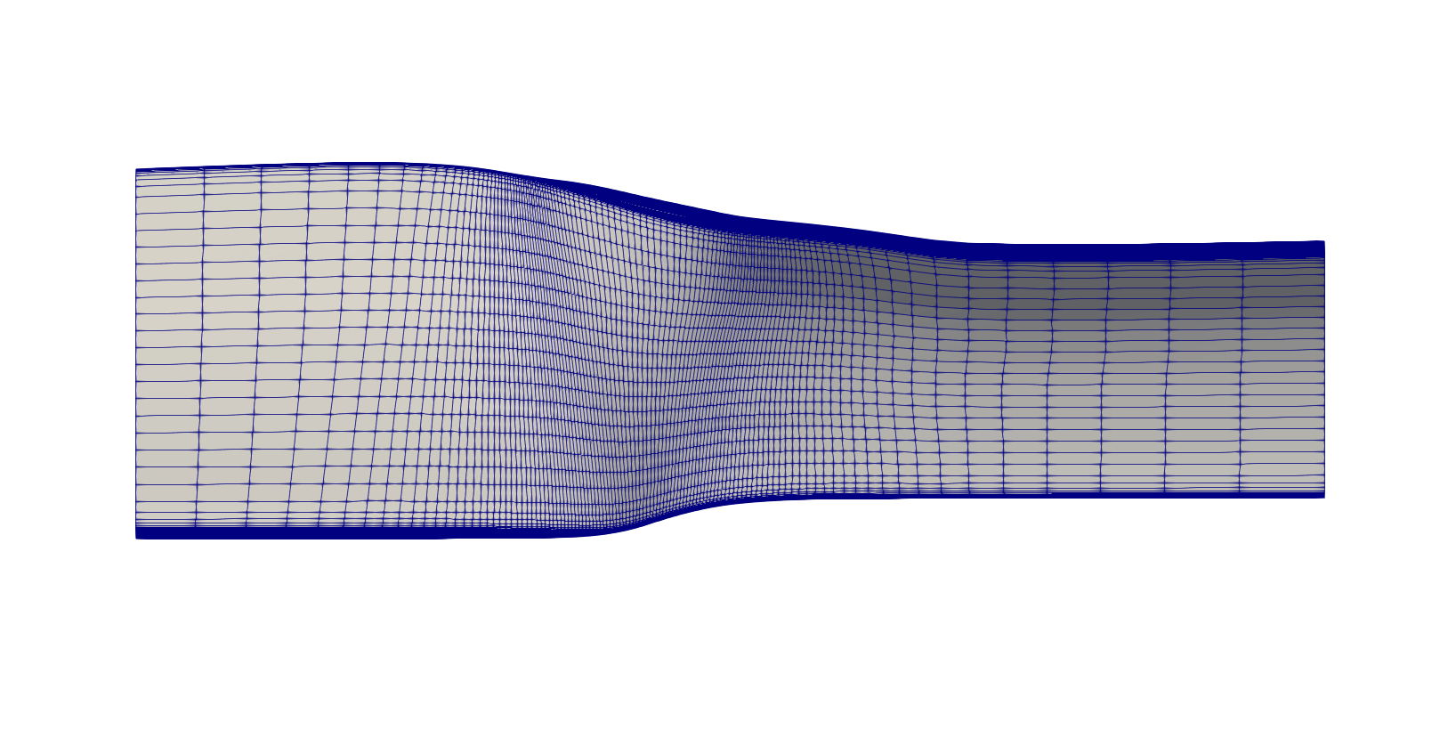
粗网格
约50万网格点
y+=0.5
viewed from top
viewed from
behind the outlet

Slide 8
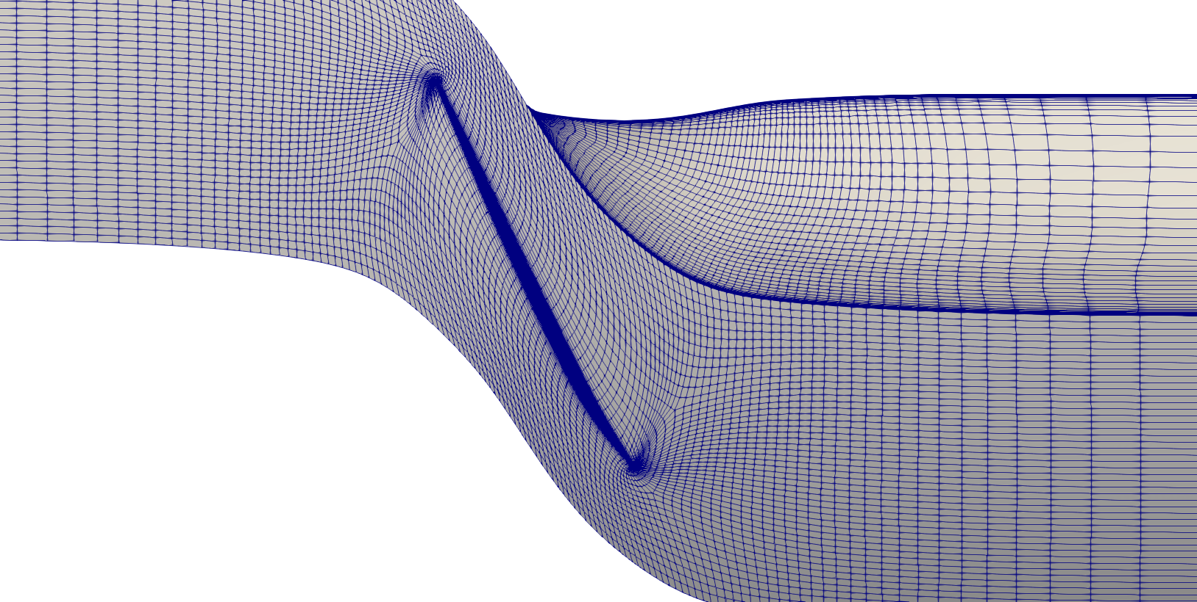
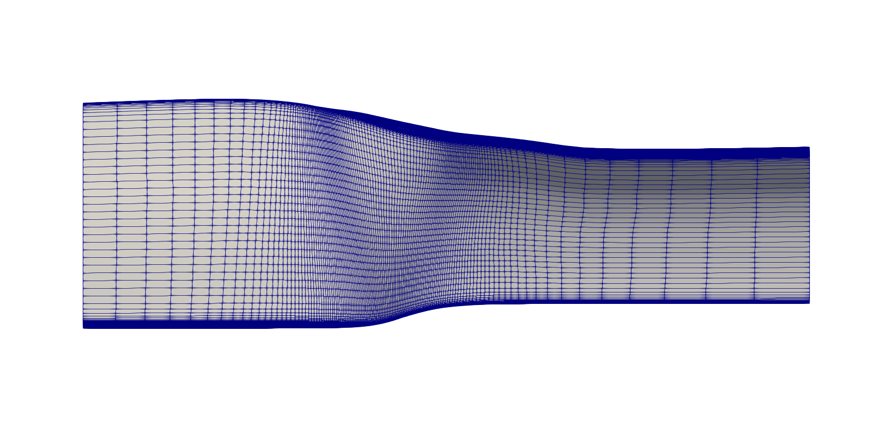
中网格
约100万网格点
y+=0.5
viewed from top
viewed from
behind the outlet

Slide 9
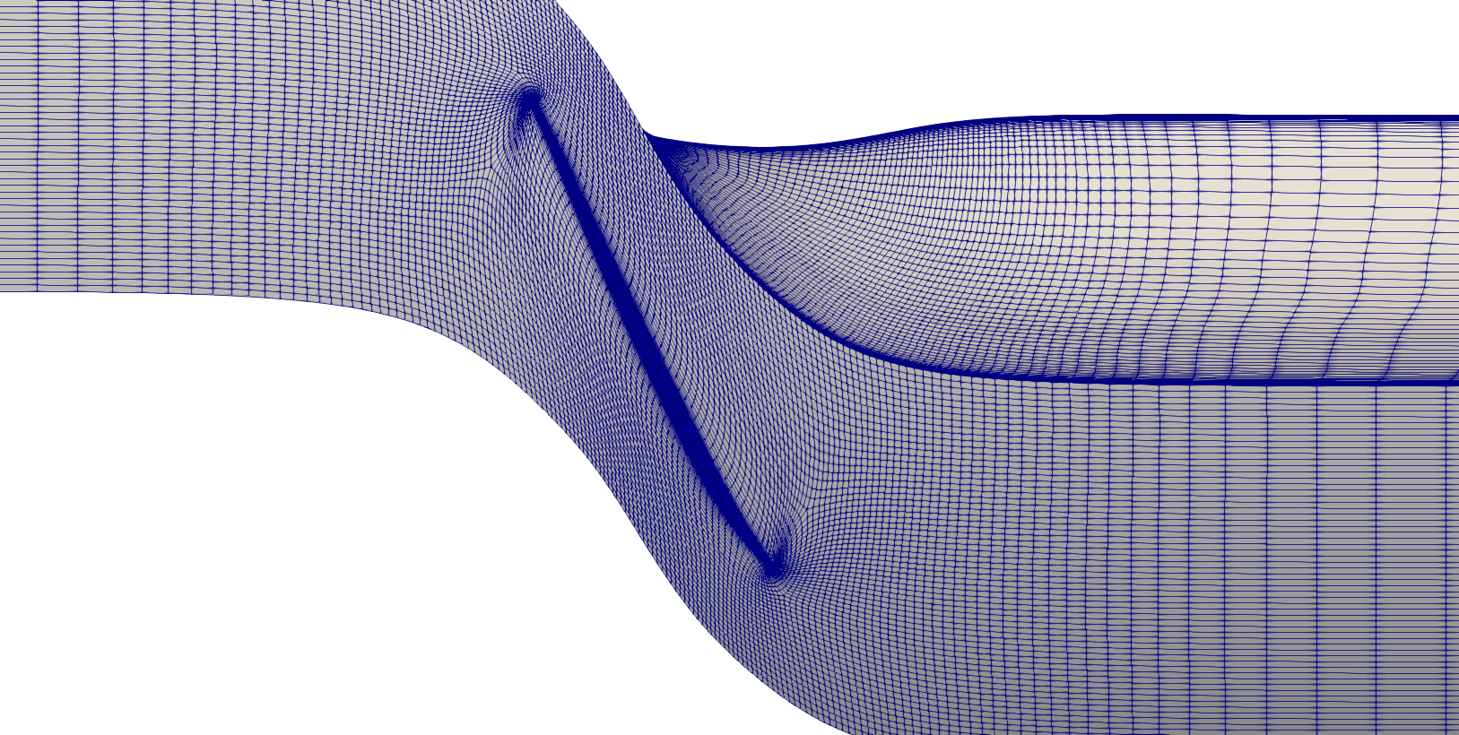
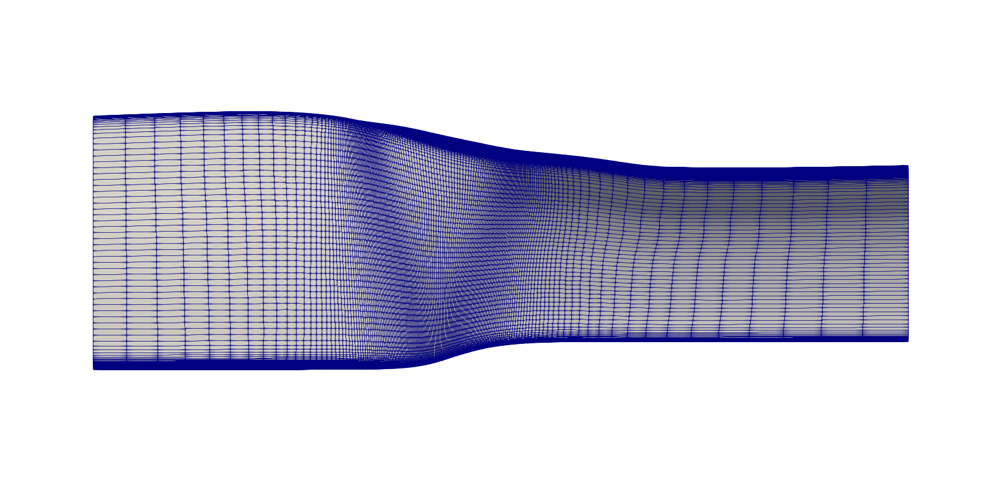
密网格
约200万网格点
y+=0.5
viewed from top
viewed from
behind the outlet

Slide 10
粗网格
中网格
细网格

Slide 12
Update on the eigenvalue analysis using ARPACK
Shenren Xu

Slide 13
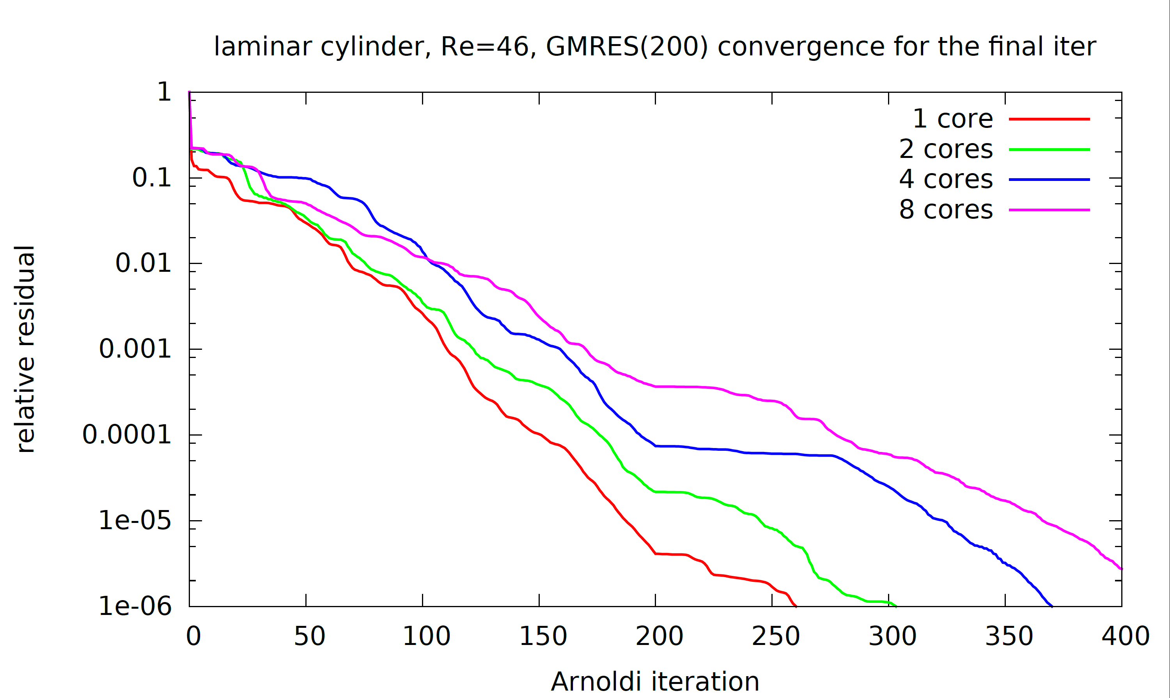
Case 0 description
Compute the critical eigenvalues laminar flow around cylinder
59200 grid points (2 layers in z-direction, thus 29600 grid points in 2D)
The linear solver convergence for the last nonlinear iteration at Re=46 is shown below for different number of cores.
The convergence rate deterioration with increased number of cores is not so bad for this case.

Slide 14
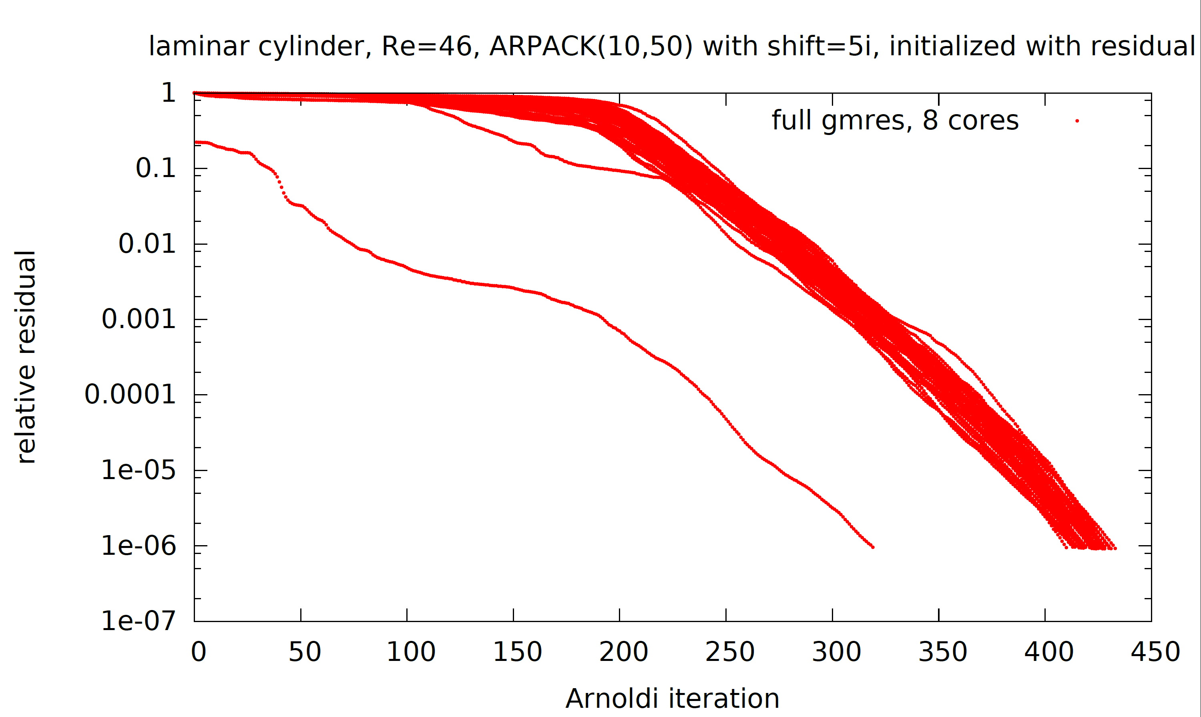
Case 0 eigenvalue analysis
Compute the critical eigenvalues laminar flow around cylinder
Compute the eigenvalue at Re=46 with full gmres (tol=1e-6). Search for 10 eigenvalues for shift=5i, with maximum 50 Krylov vectors. Initialized with residual vector. 10 eigenvalues found after 50 ARPACK outer iter.
First linear solve
Subsequent 49 linear solves

Slide 15
Case 0 linear solver behavior
10 eigenvalues are correctly found using different initialization
(1) Random (2) Unit vector (3) Flow solution vector (4) Flow residual vector
Full GMRES used to converge each inner linsolve to tol=1e-6
All run with 8 cores
Number of outer iterations to converge ARPACK
Random vector： 80
Unit vector: 82
Flow solution: 79
Residual: 50

Slide 16
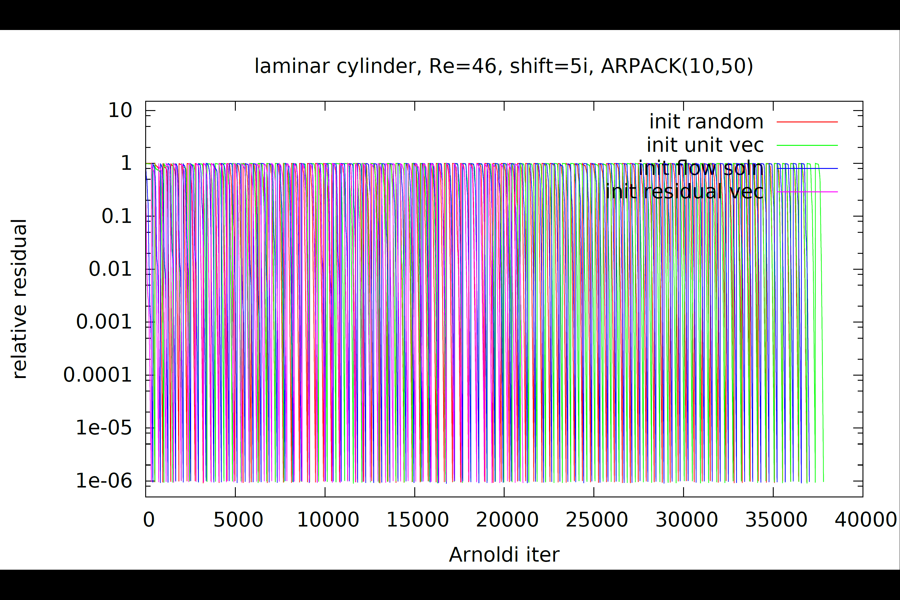
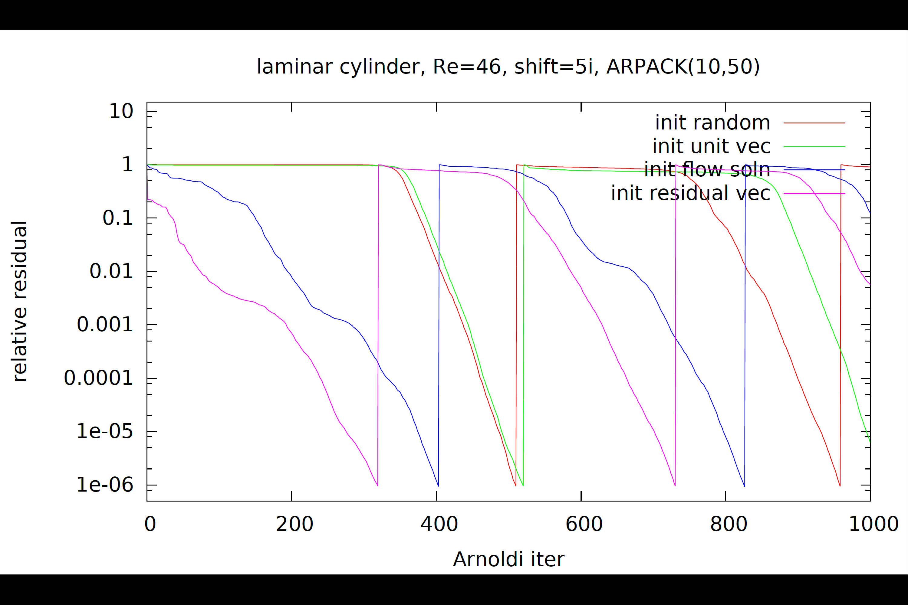
Case 0 linear solver behavior
Detailed convergence history for all runs (all are based on full GMRES on 8 cores)

Slide 17
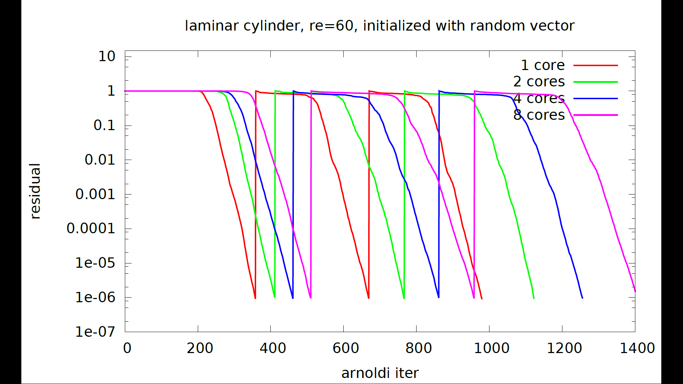
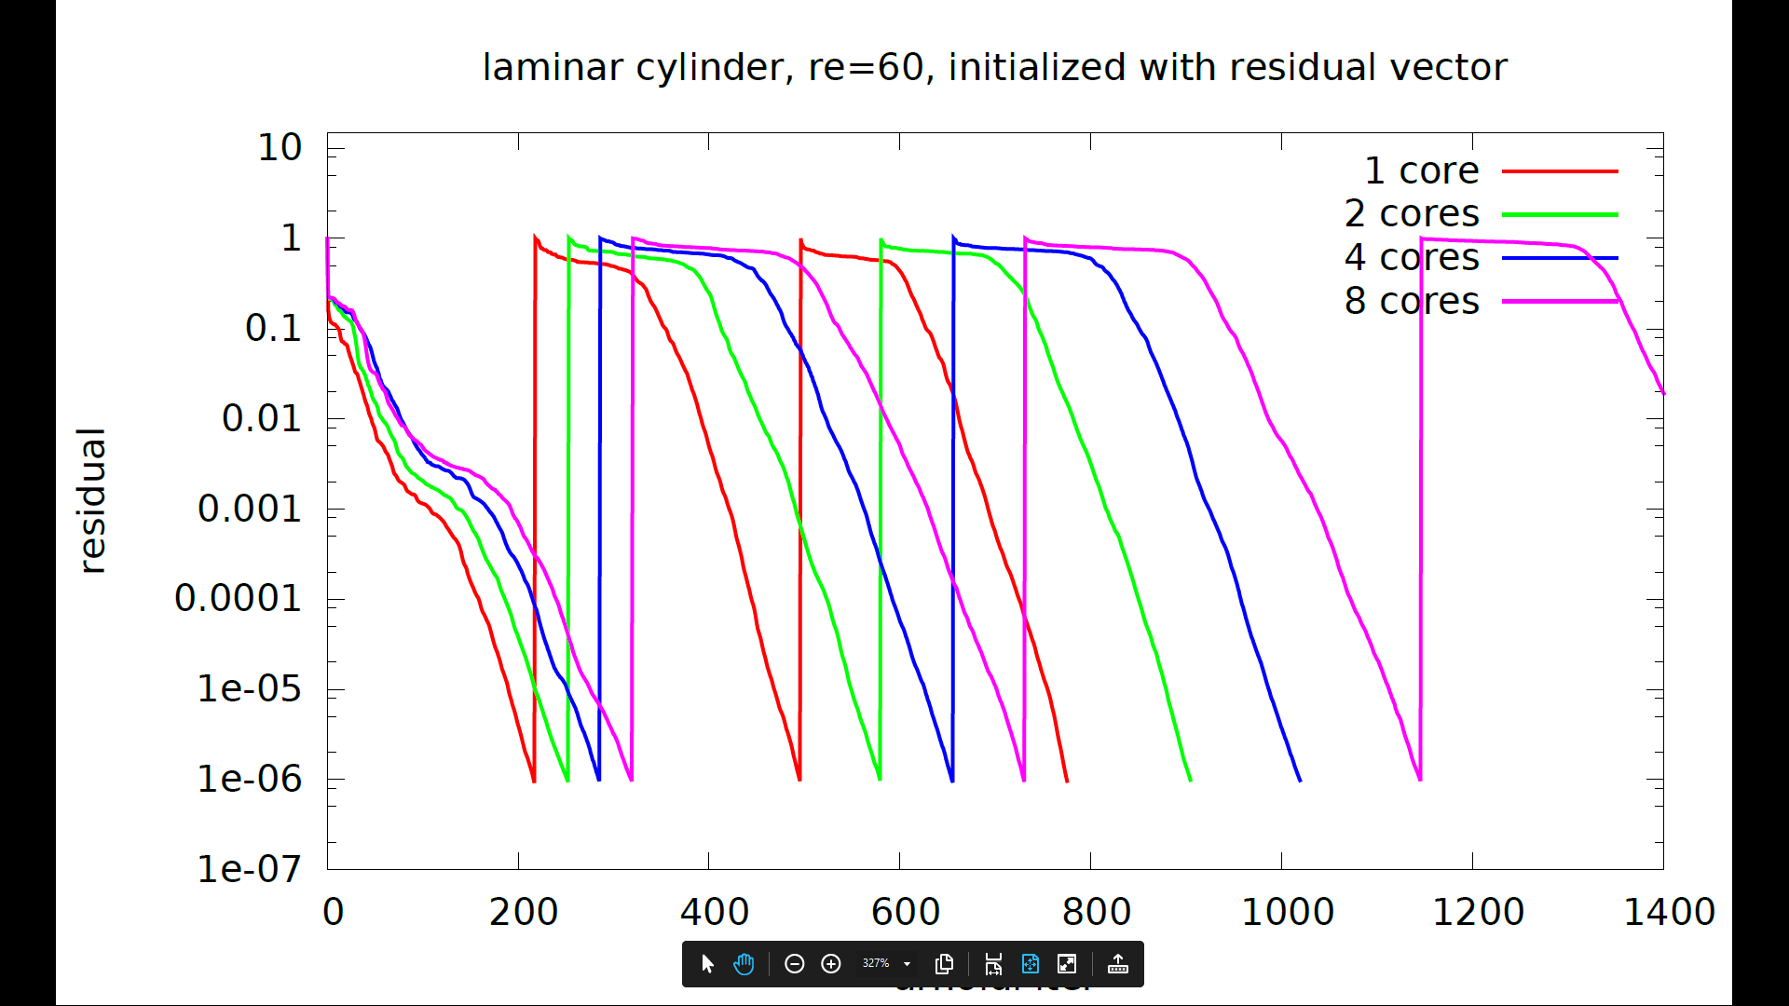
Case 0 linear solver behavior
1 v.s. 2 v.s. 4 v.s. 8 cores, for initialization with random vector (choice 1) and residual vector (choice 4)
“Smooth” convergence rate deterioration from 1 to 8 cores

Slide 18
Case 0 summary
Initializing arpack using the residual leads to fastest convergence
As long as the inner linear solve converges, the choice for initialization does not make a difference to the final eigenvalue results.
For initialization with either random or residual vectors, the convergence rate deterioration is rather “smooth” , unlike the Rotor67 case.
Now a bit more confidence in the parallelism of GMRES, and thus the periodic boundary treatment (which is not used for this cylinder case) a bigger suspect.

Slide 20
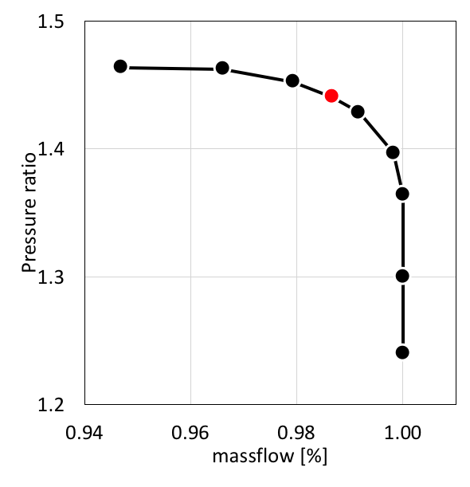
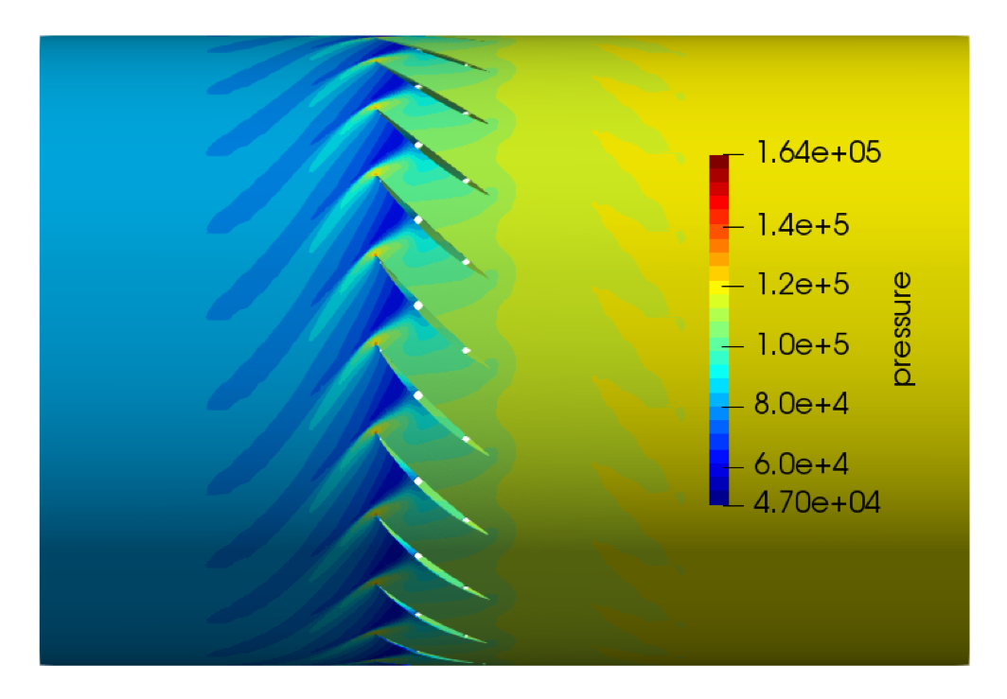
Case 1 description
Compute the critical eigenvalues for NASA R67 annular cascade
Created by taking the surface of revolution at 50% blade height of R67
Full annulus consists of 22 blades (airfoils)
The mesh is prepared to be cyclic symmetric-create mesh for one passage and then copy to other 21 passages ( in total 126,808 grid points)
The pressure ratio v.s. massflow is computed by incrementally raising the back pressure while keeping the inflow total condition constant (lower left)
The pressure contour plot for the condition in red is shown lower right.

Slide 21
Two approaches are used to compute the eigenvalues
Approach 1: export the Jacobian matrix to file and use Matlab eigs to compute eigenvalues near different shifts. Results shown below.

Slide 22
Two approaches are used to compute the eigenvalues
Approach 2: create a module (a wrapper for “znaupd” ) in the flow solver NutsCFD and use the linear solver already existing in the Newton-Krylov flow solver to solve （A-sigma*I）x = b, where sigma is the complex shift.
Several parameters need to be set:
ARPACK setting:
Invert-shift mode, with shift = 1i
max. 300 iterations, Krylov subspace dim. = 20, search for 10 eigenvalues,
4 choices tried: (1) random vector (2) unit vector (3) flow solution (4) residual vector
→ following slides main show the influence of choices 1 to 4.
Linsolve setting:
ILU(0) based on 1st-order Jacobian as right preconditioner
ILU(0) parallelism is additive Schwarz paradigm (decoupled across subdomains)
GMRES(500), maximum two restarts, i.e., total 1000 Arnoldi iterations.

Slide 23
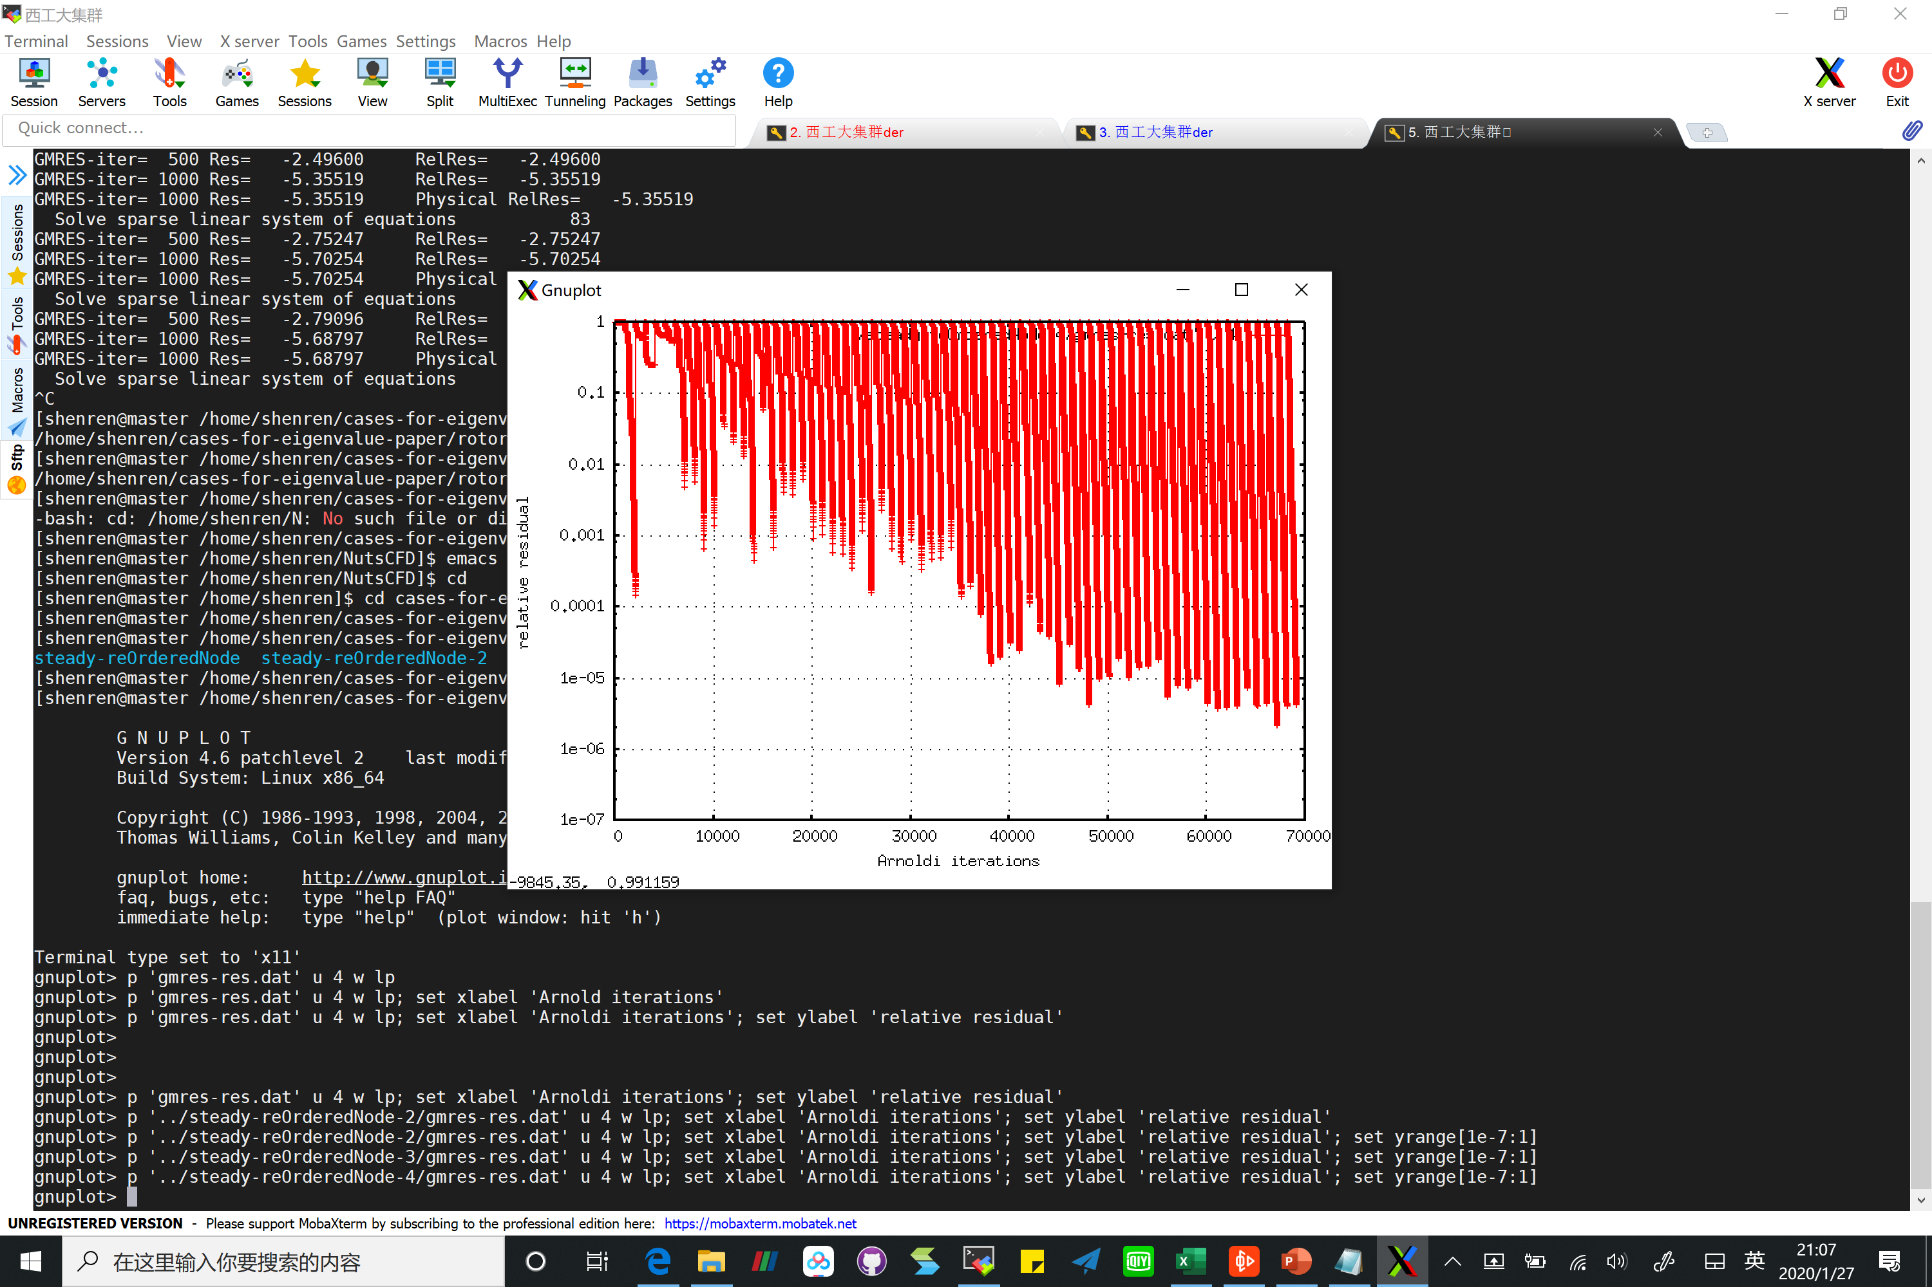
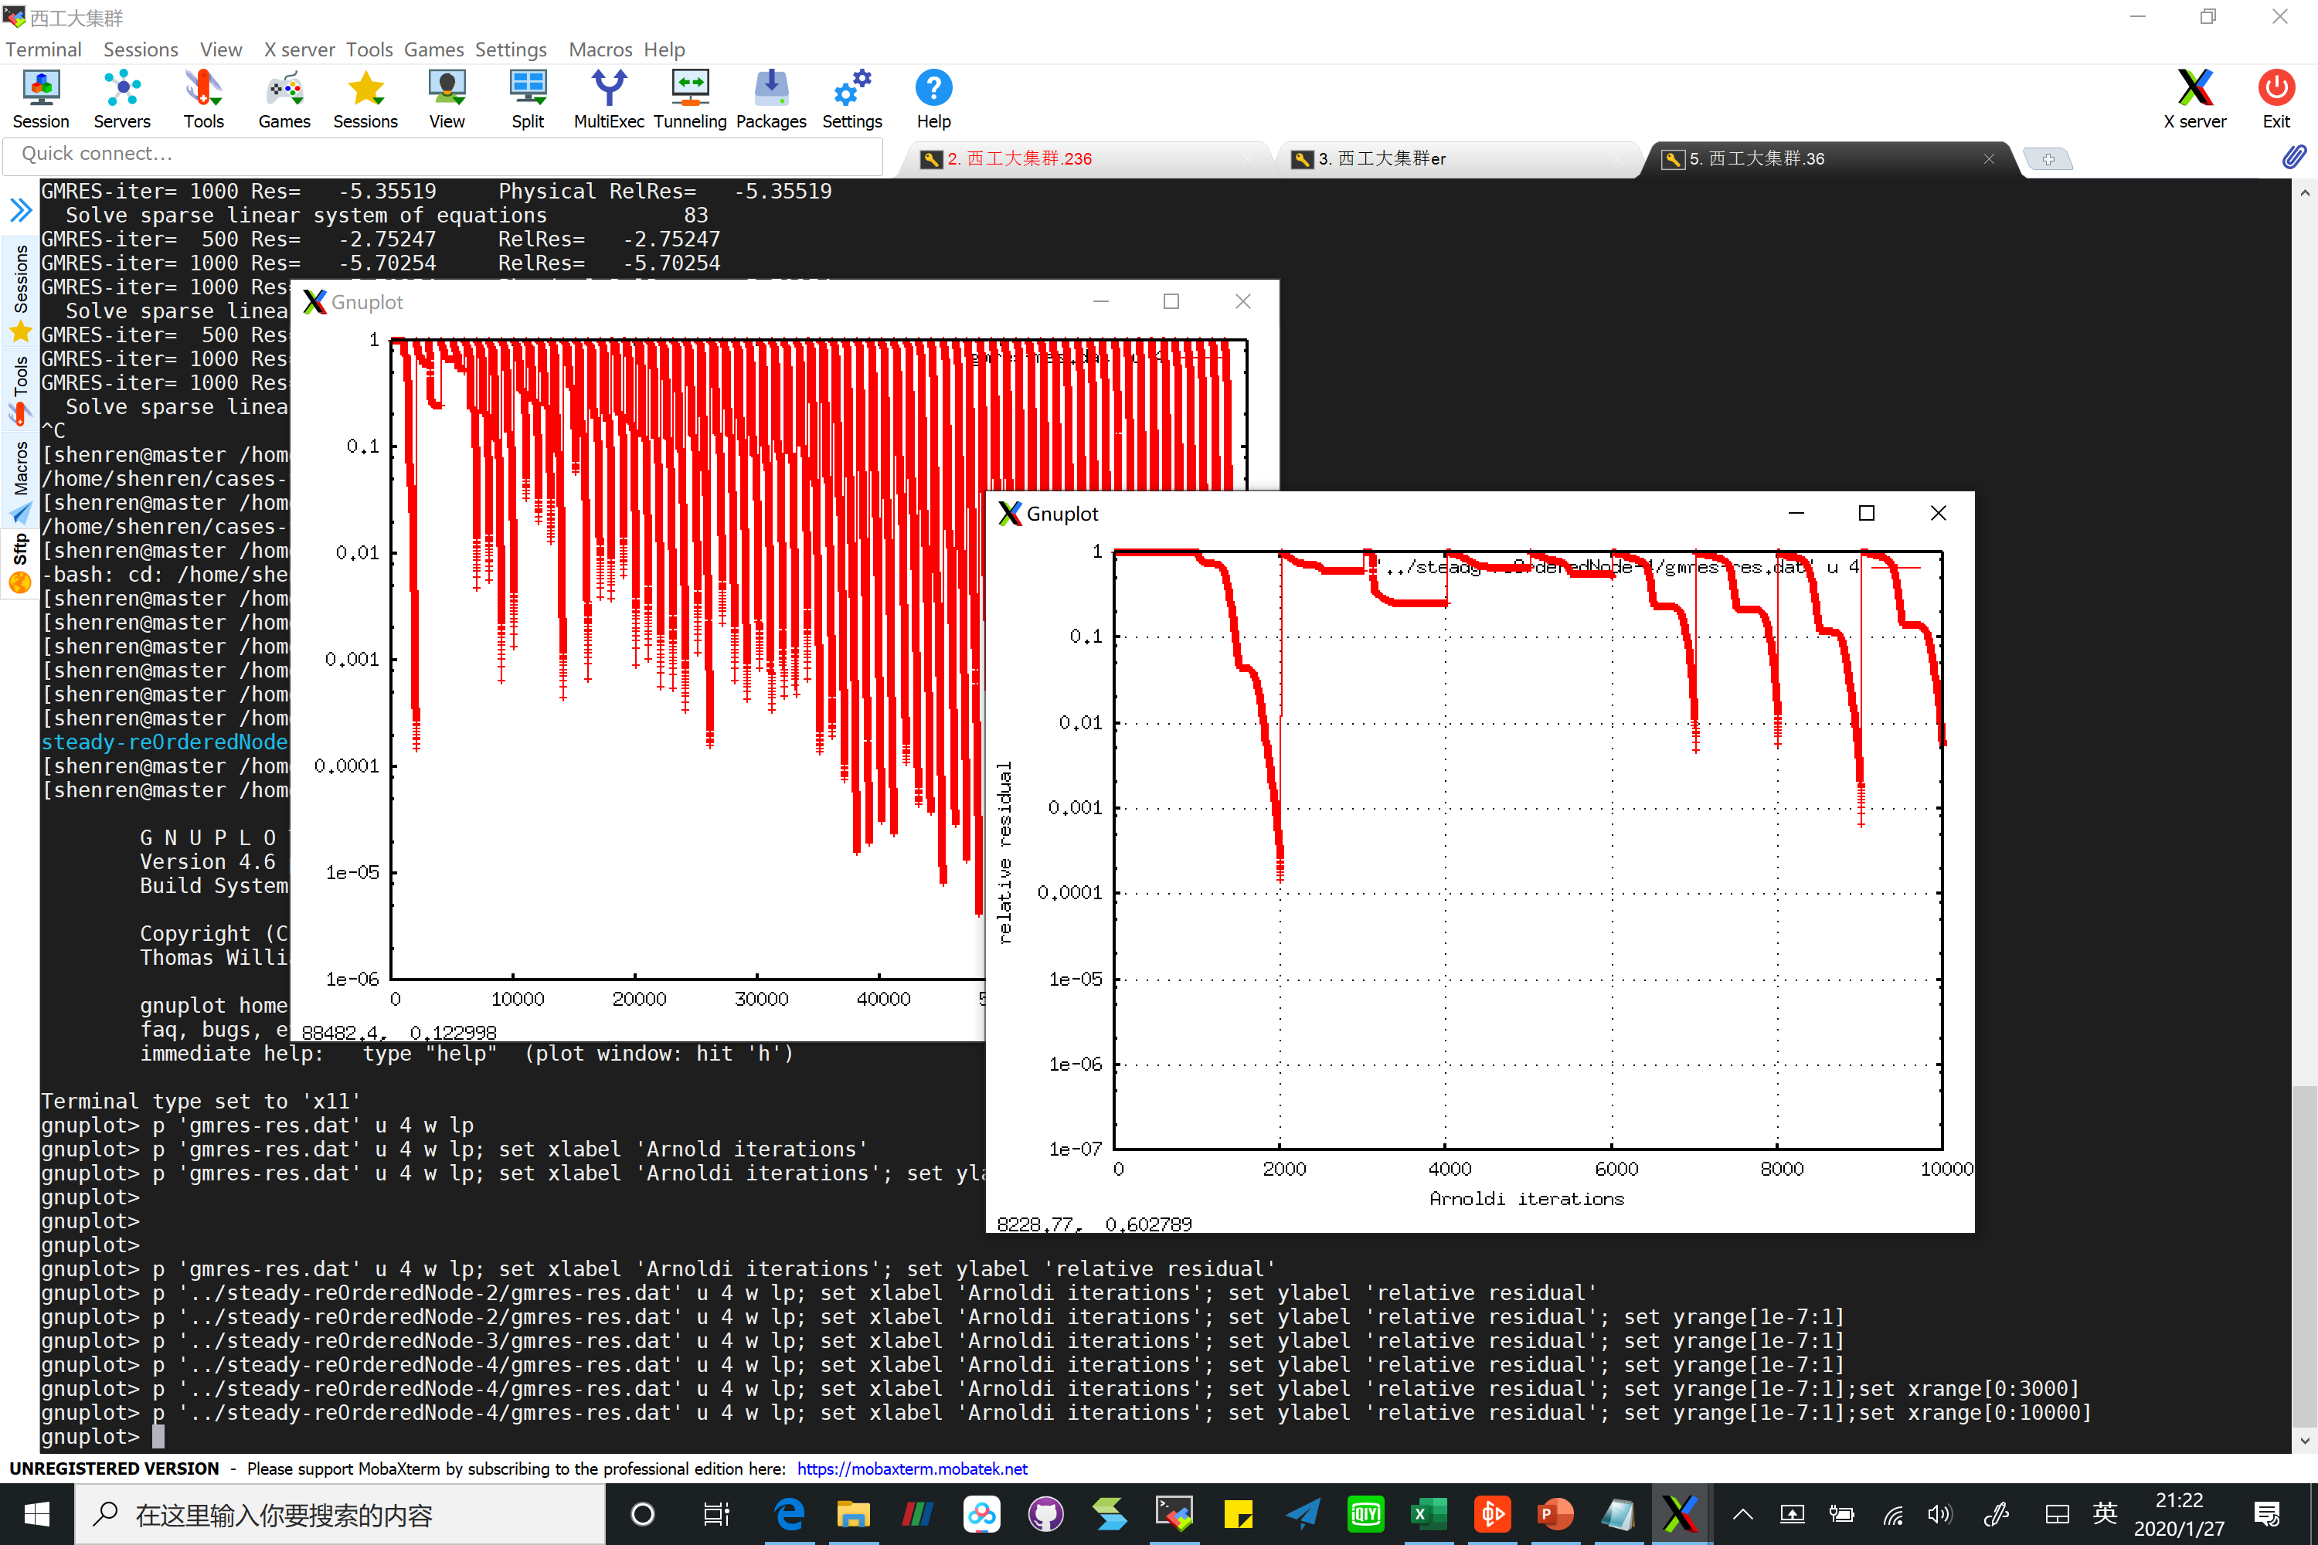
Choice 1, random vec (ARPACK default opt)
Eigenvalues computed are wrong
Linear solver convergence
First 10 steps in ARPACK
1 2 3 4 5 6 7 8 9 10
Stall ok stall stall stall stall ok ok ok ok

Slide 24
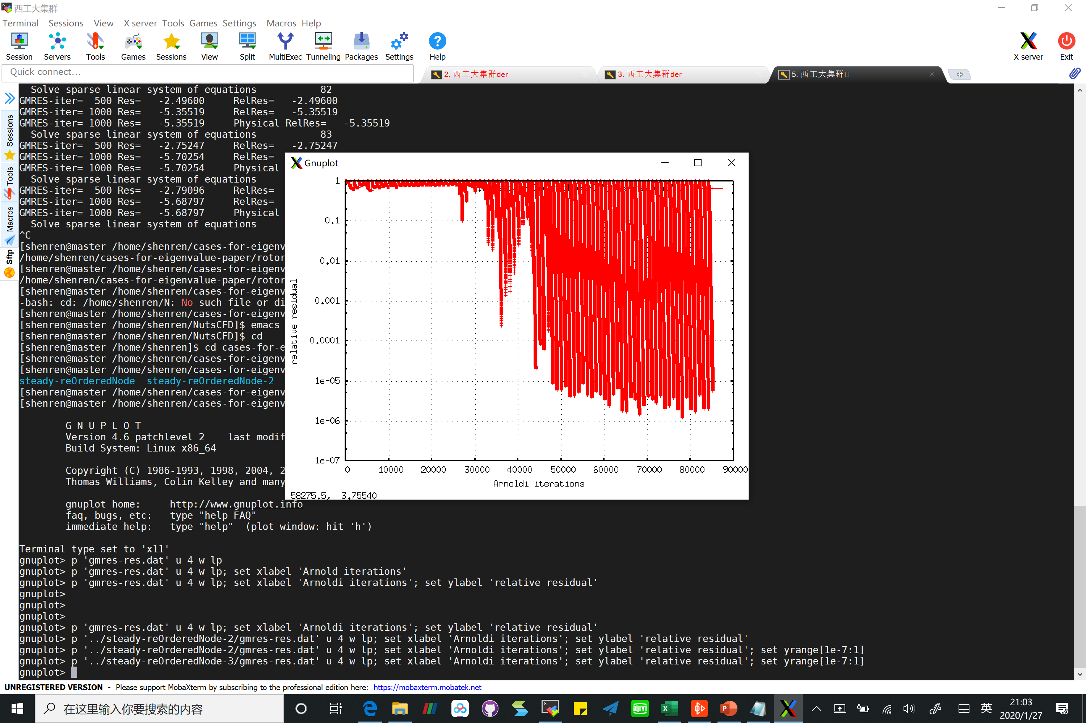
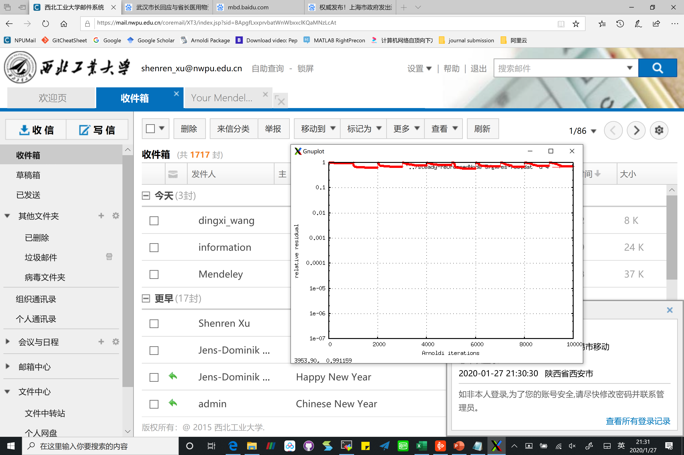
Choice 2, init with unit vector
Eigenvalues computed are wrong
Linear solver convergence
First 10 steps in ARPACK
1 2 3 4 5 6 7 8 9 10
Stall stall stall stall stall stall stall stall stall stall

Slide 25
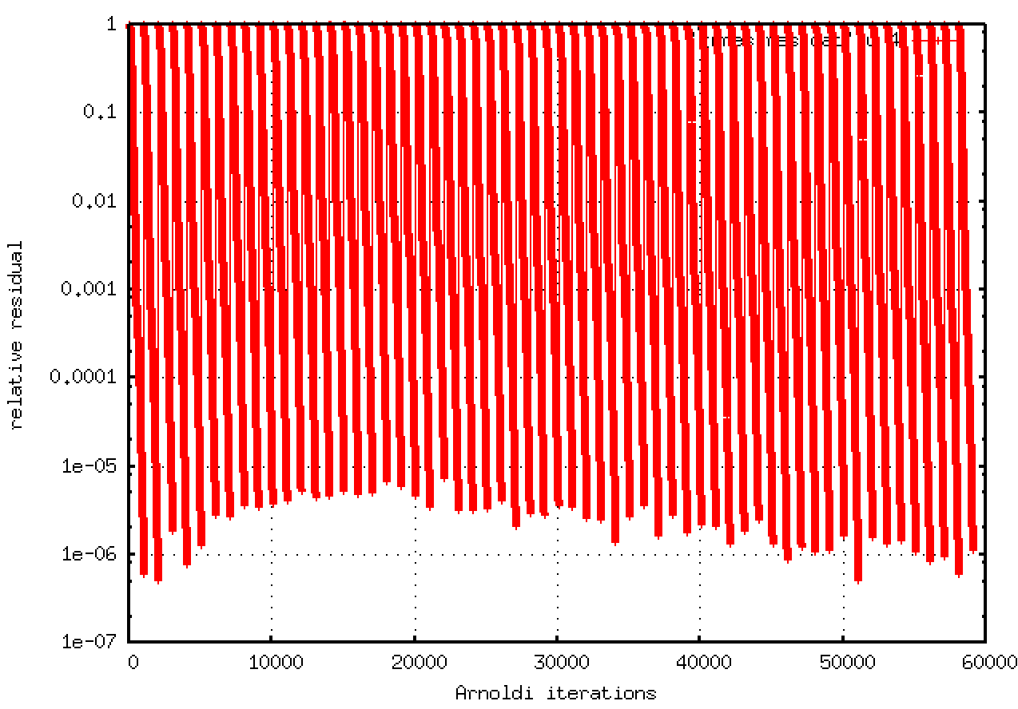
Choice 3, init with flow solution
Eigenvalues computed are correct
Linear solver convergence

Slide 26
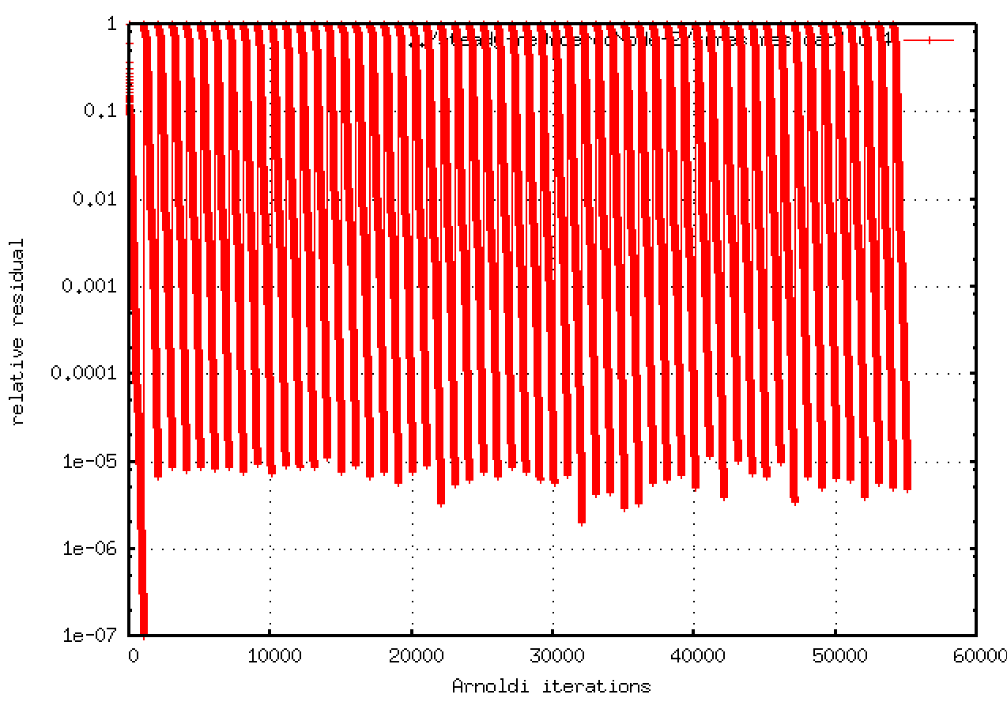
Choice 4, init with residual vector
Eigenvalues computed are correct
Linear solver convergence

Slide 27
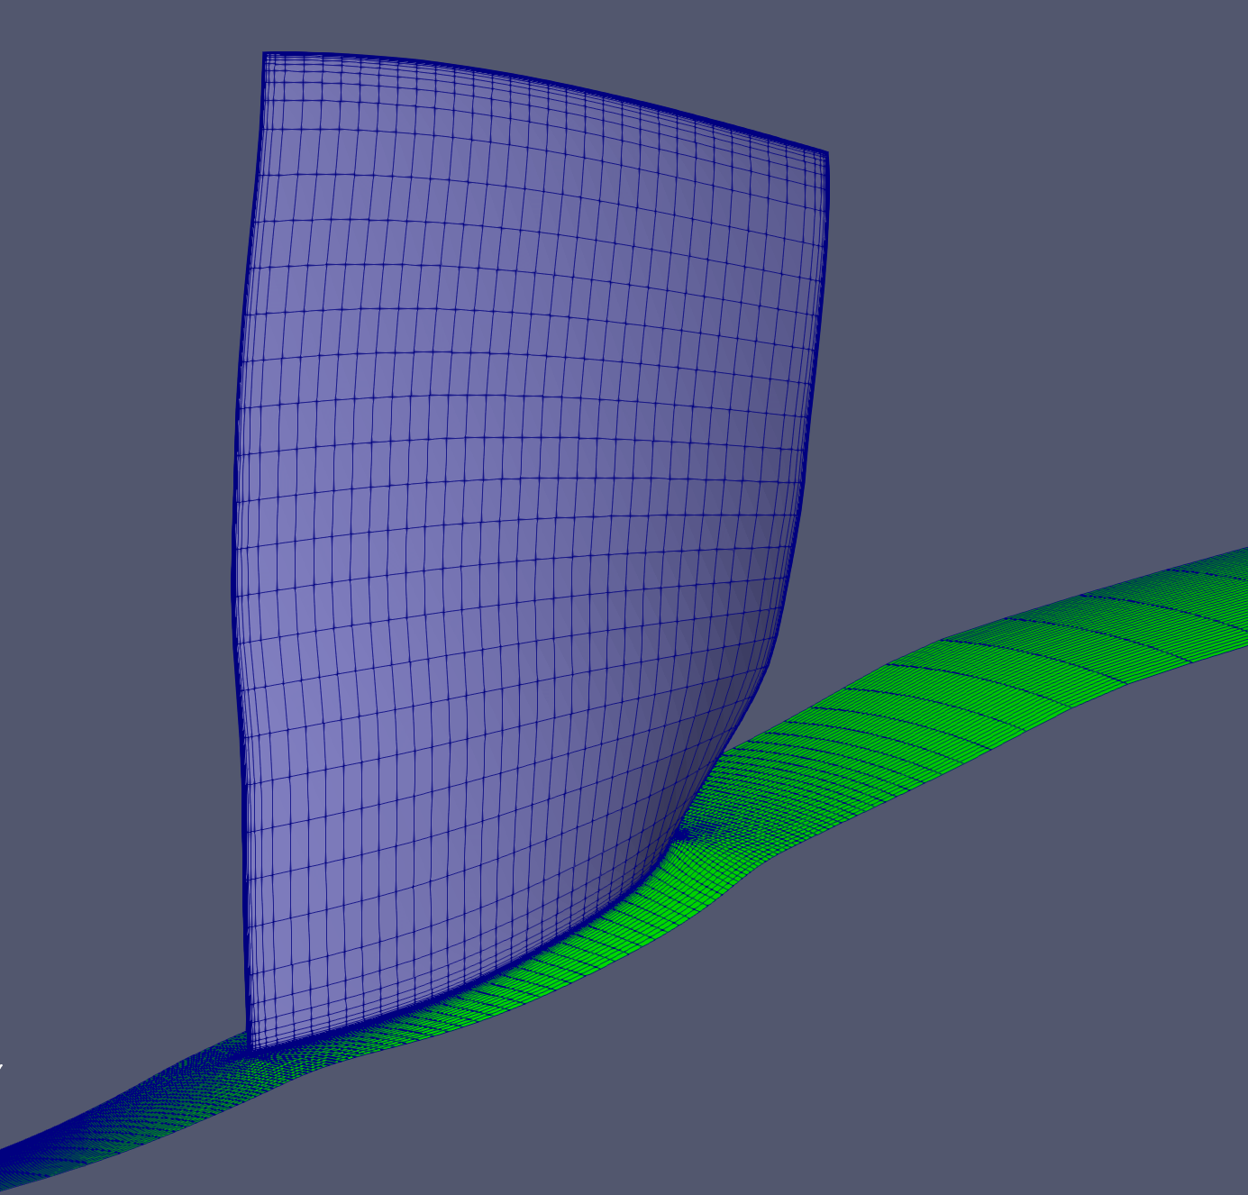
Case 2 description
Compute the critical eigenvalues for NASA R67 single passage
Periodic boundary condition imposed for the flow calculation
A total of 594,617 grid points
The pressure ratio v.s. massflow is computed by incrementally raising the back pressure while keeping the inflow total condition constant (lower right)
Perform eigenvalue
analysis for this point

Slide 28
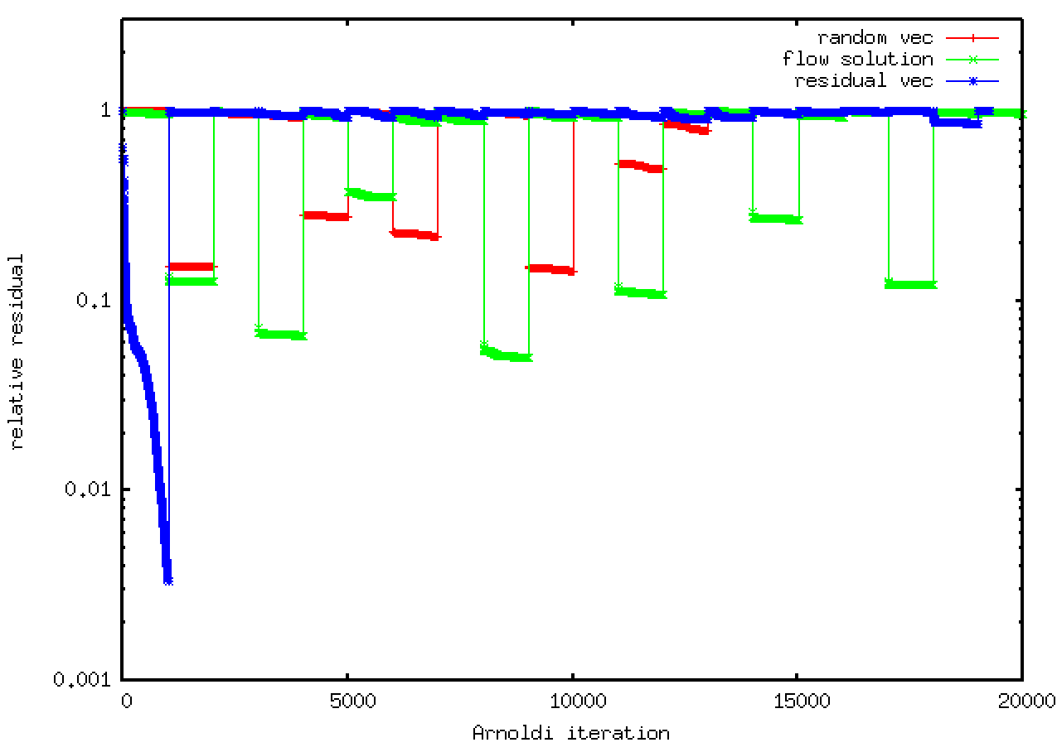
Linear solver convergence for choices 1-4
Very different convergence behavior for different choices of initialization for the ARPACK outer iterations.
None of the 4 choices lead to a successful eigenvalue analysis…
GMRES(1000) without restart is used as linear solver
ARPACK complex shift=0 (similar behavior for non-zero shifts)
But initialization with residual vec seems promising. Maybe GCRO-DR-R can save the convergence stall from the 2nd outer iteration?...

Slide 29
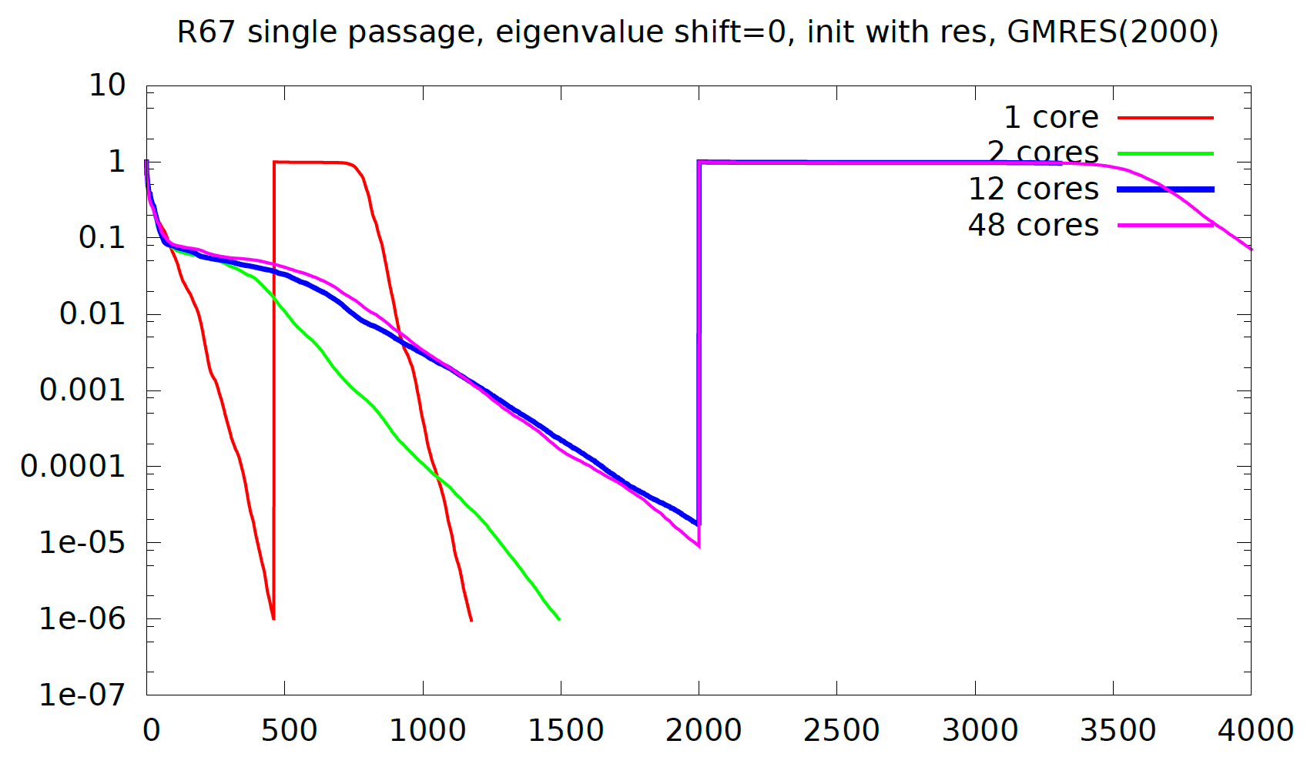
GMRES convergence for init with residual
There seems to be a sudden change from 1 to 2 cores and less change from 2 cores to even more cores.

Slide 30
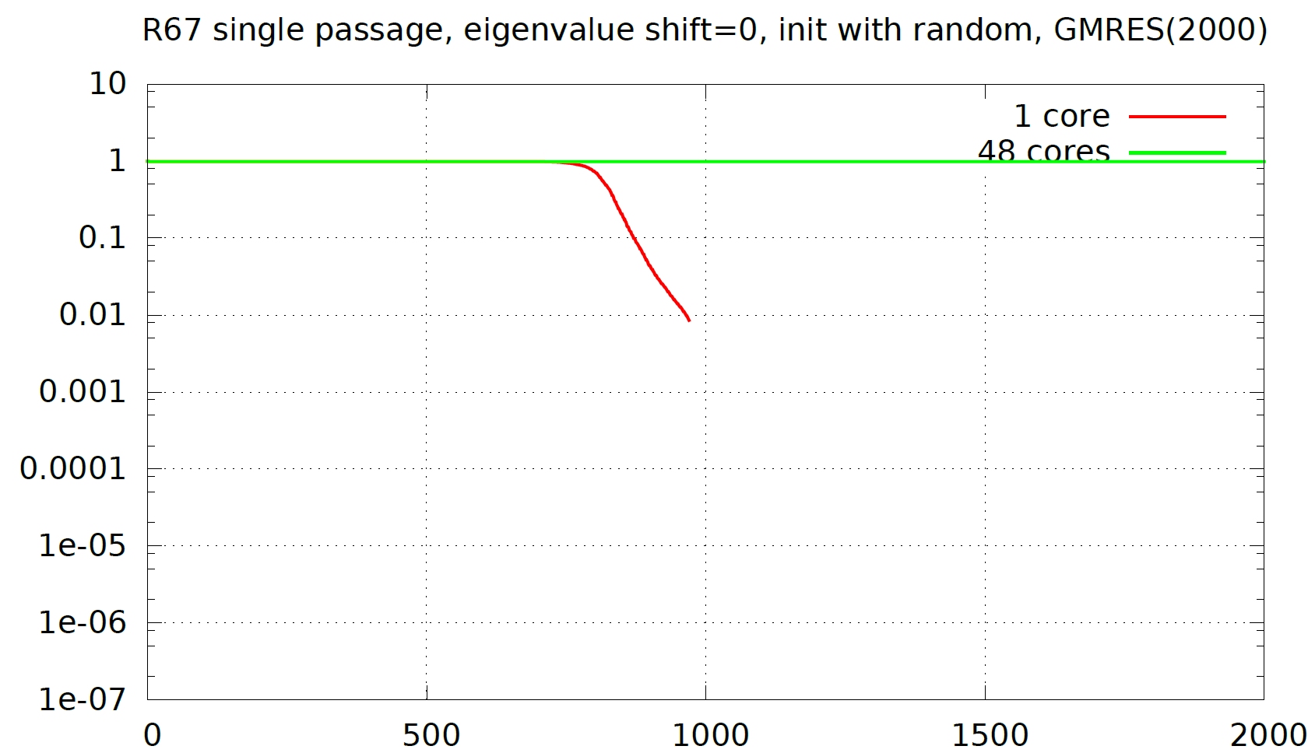
GMRES convergence for init w/ random vec
When initialized with random vector, Gmres(2000) stalls for 2, 12, 48 cores.
GMRES(2000) does not stall only for 1 core.

Slide 31
GMRES convergence
The deterioration of local-ILU from 1 to 2, 12, 48 cores is significant, when the RHS of the linear system is either the residual vector or a random vector.
Need to check
the implementation of the parallelism of GMRES and local-ilu
the implementation of the parallel treatment of periodic bc in Jacobian
Check the implication of bdry_set_res in init-random
If no bug is found, go on with GCRO-DR-D, which will allow the successful convergence of all linear solves when ARPACK is initialized with residual vec.

Slide 32
How lossy is local-ILU exactly, for R67-3d
It’s inevitable that local-ilu is lossy for parallel runs. I’m interested in how much fill-in is lost with more cores. Distributed Jacobians are shown below. They are not lossy in parallel runs.
Core 1/1
Core 1/2
Core 1/4
Core 2/4
Core 2/2
Core 3/4
Core 4/4

Slide 33
How lossy is local-ILU exactly, for R67-3d
The distributed local-ilu matrices are shown below. They are lossy in parallel runs (the nonzero entries in the grey zones are zeroed). The loss is measured by the ratio of the discard off-diagonal entries over the total entries.
Core 1/1
Core 1/2
Core
1/4
Core
2/4
2/4
Core 2/2
Core
3/4
Core
4/4

Slide 34
Deterioration of local-ilu over many cores
From 1 to 2 cores, loss is less than 1%, why big deterioration in the preconditioning effect?
Does this case happen to be a borderline case or is GMRES implementation faulty?

Slide 35
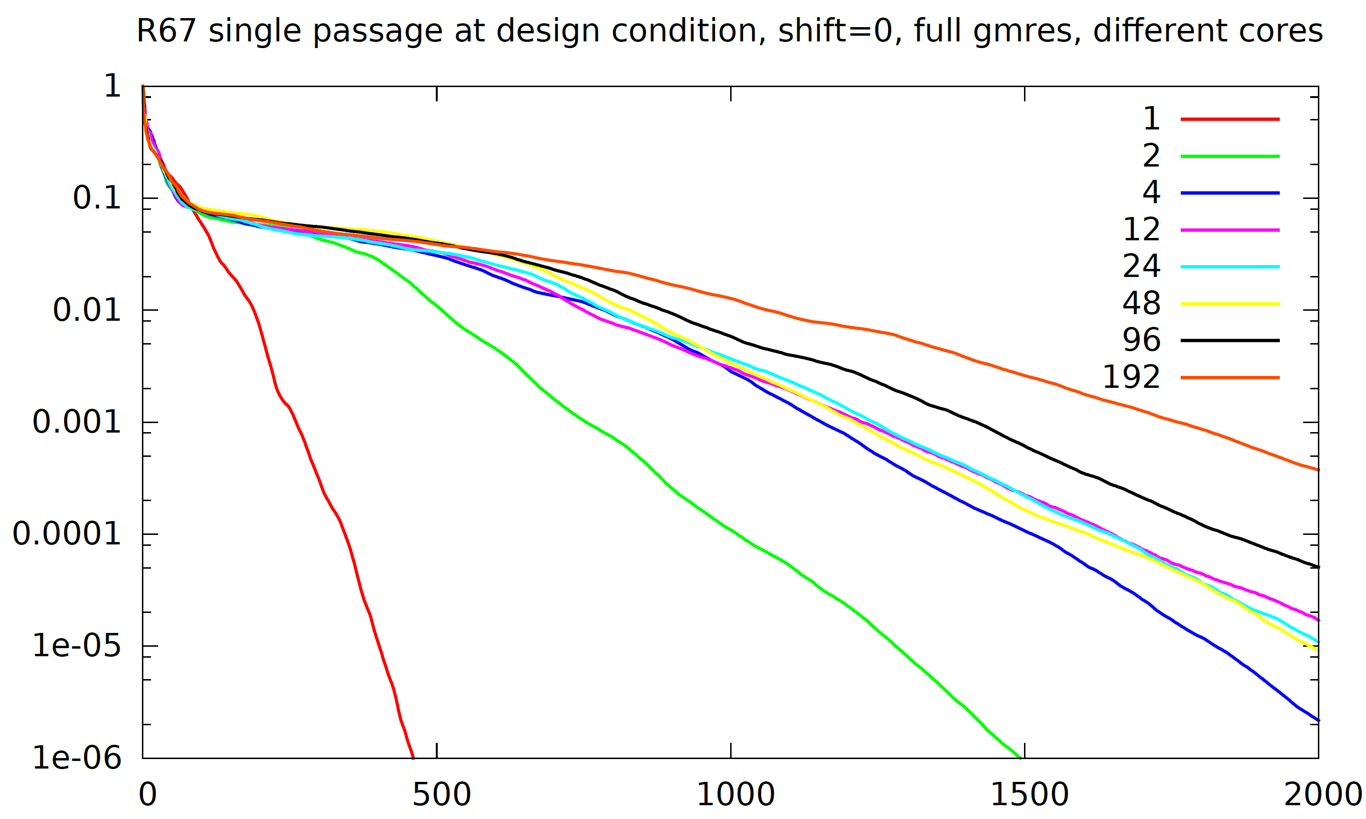

Slide 36
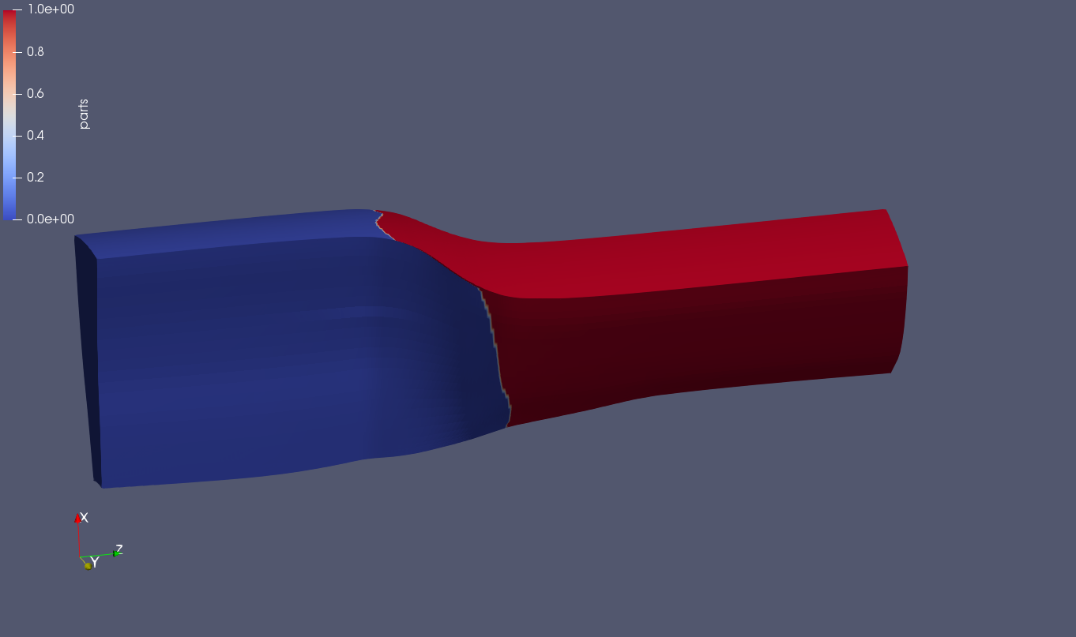
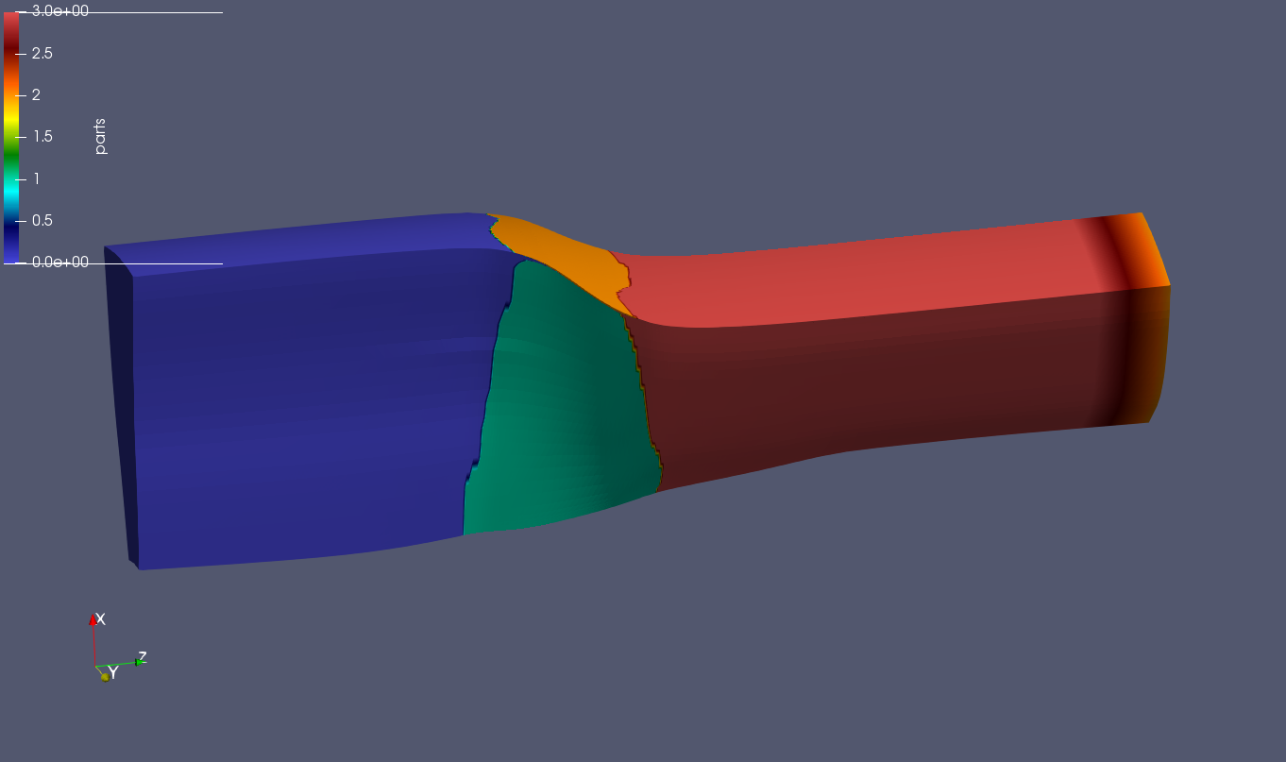
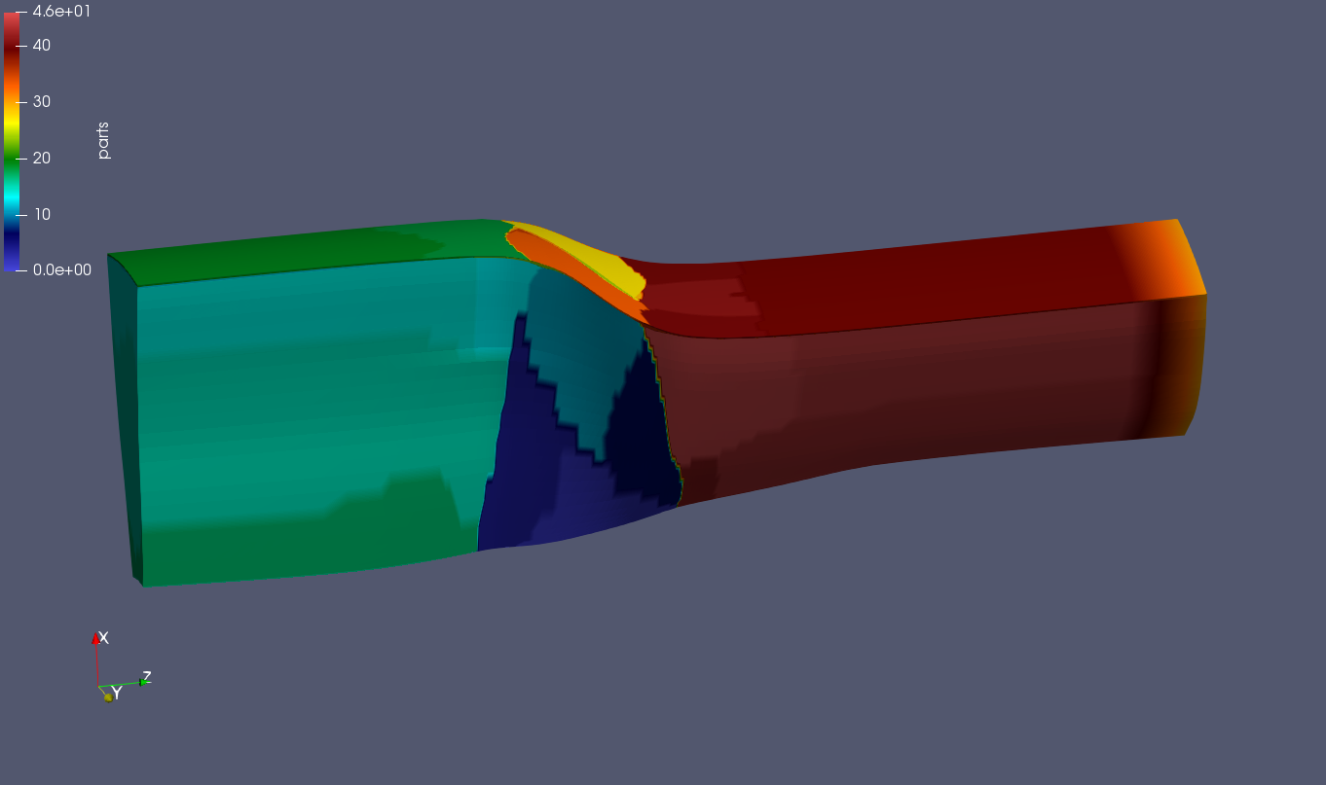
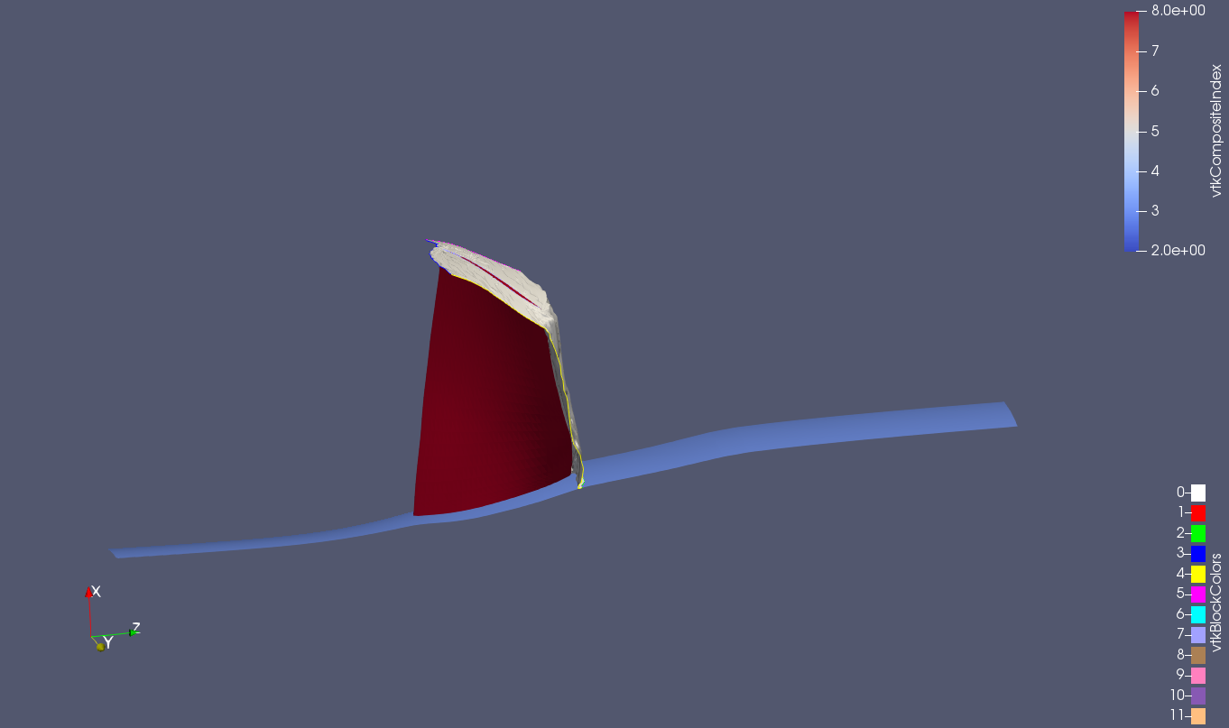
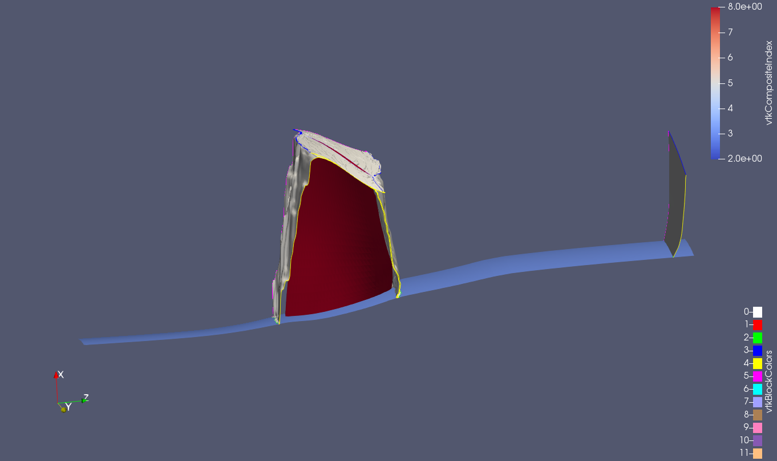
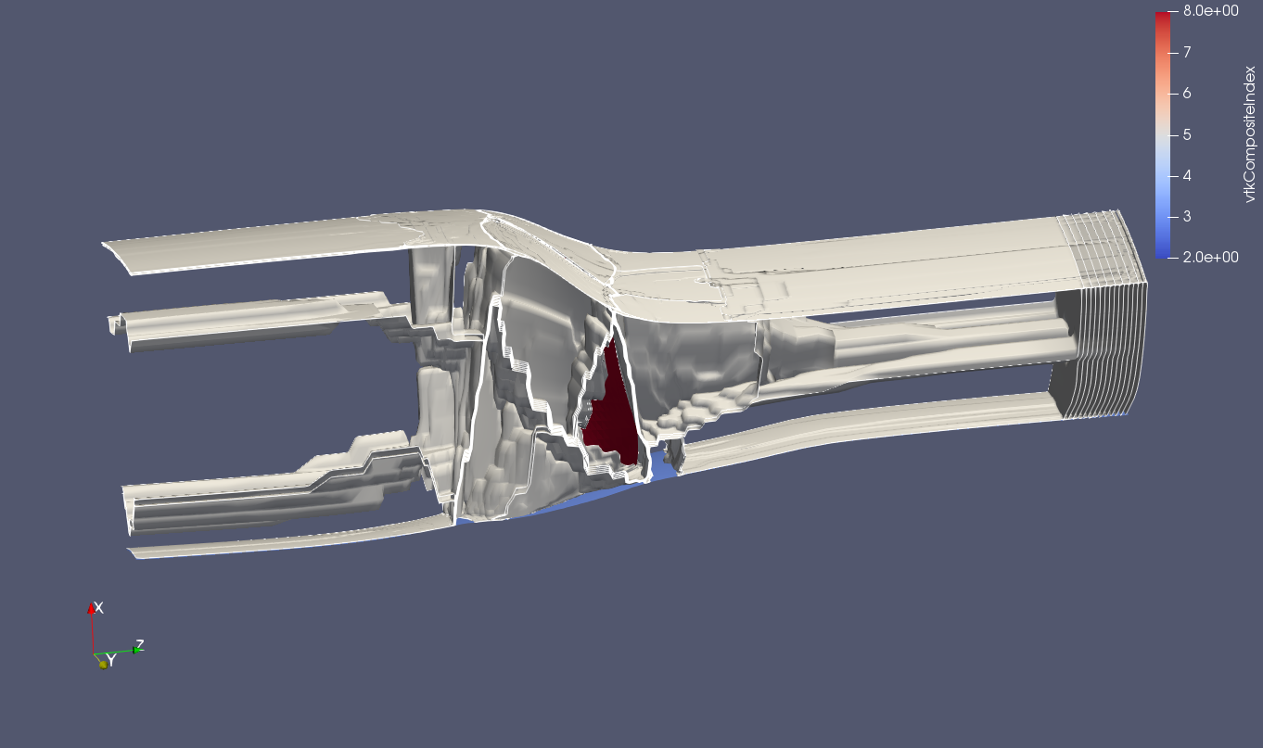
2 cores 4 cores 48 cores
Maybe the huge convergence rate deterioration from 1 to 2 cores is due to the fact that
the partitioning boundary happens to be at the most sensitive location of the flow field???

Slide 37
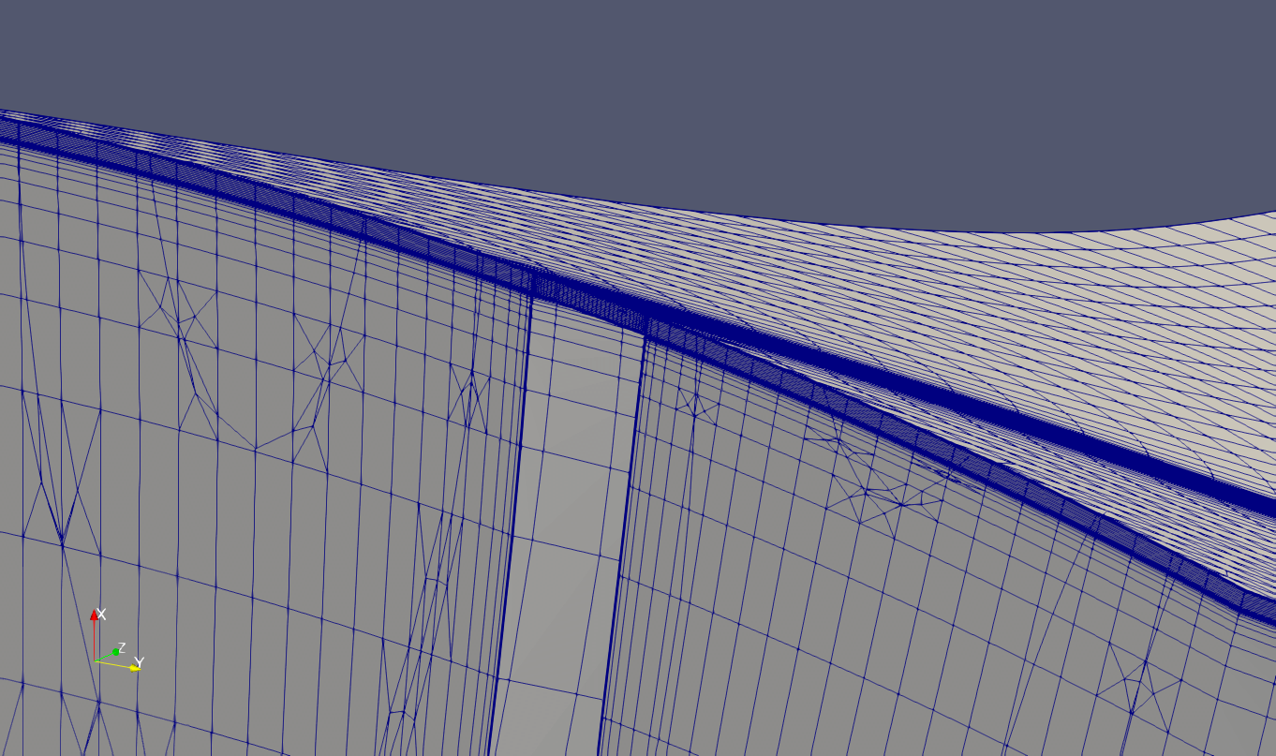
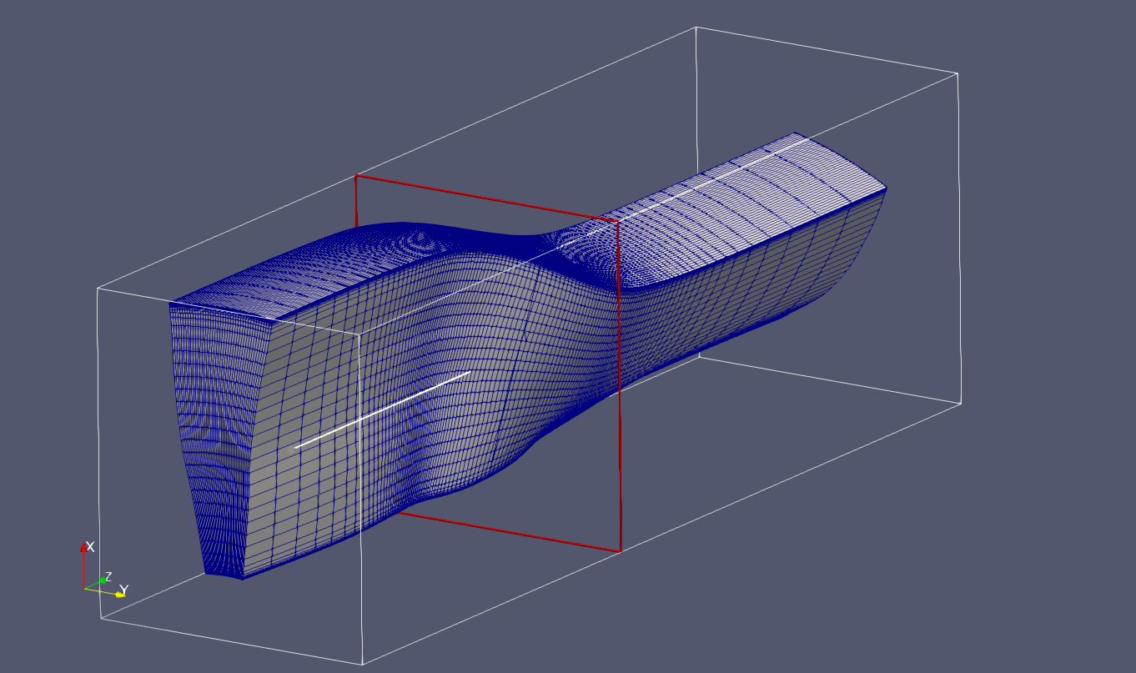

Slide 38
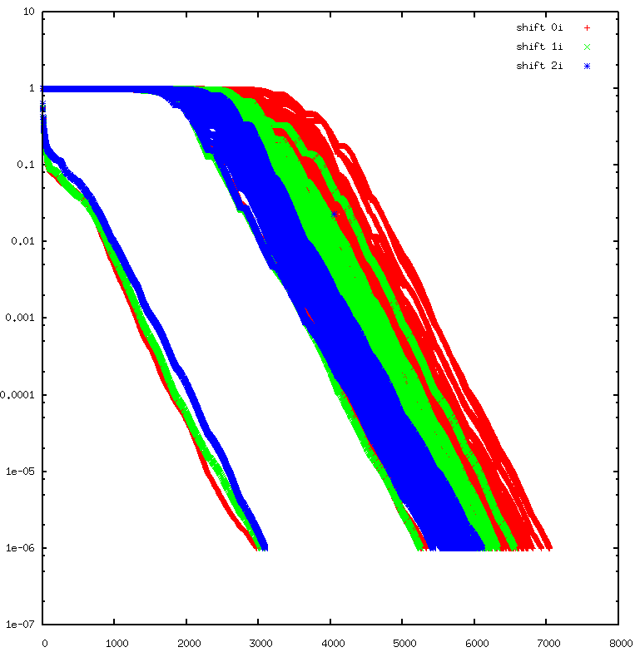
Rotor67 design condition eigen-analysis
GCRO-DR(500,50) using 48 cores
No recycling between ARPACK iterations
Each linear solver 1 to 2 hours (clock time)
ARPACK info
Shift =0, 1i and 2i
Krylov subspace dimension 50
Search for 10 eigenvalues for each shift
ARPACK results
For 3 shifts, 80/50/80 linear solves in total
GCRO-DR(500,50) convergence
First arpack iter
Subsequent arpack iter

Slide 39
Rotor67 design condition eigen-analysis
The eigen-analysis is with periodic b.c. imposed and therefore only modes with nodal diameter 0 is found.
Modes with other nodal diameters (1 through 21, as there are 22 blades), can be found by performing the same eigen-analysis for different Jacobian mat.
Other Jacobian matrices can be obtained by imposing phase-shift boundary condition on upper and lower periodic boundaries.

Slide 40
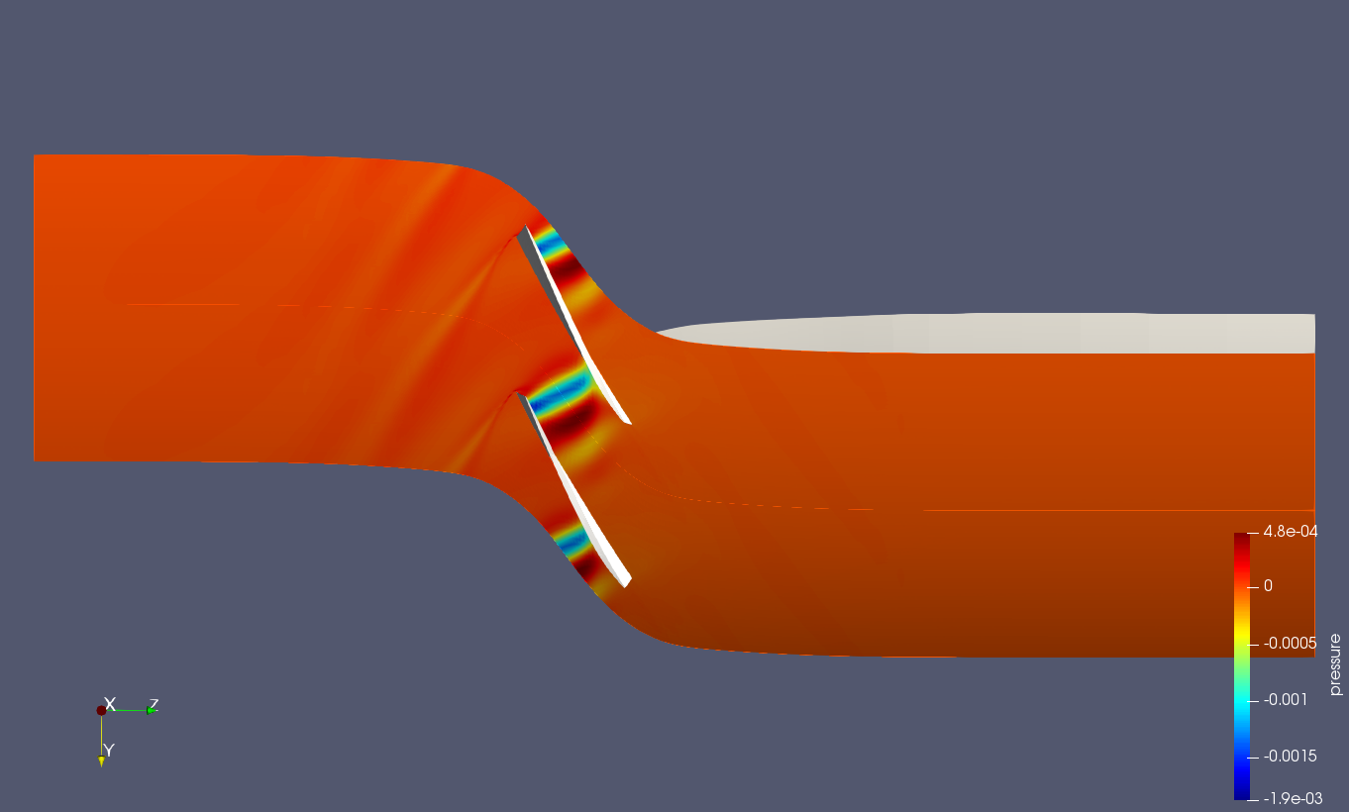
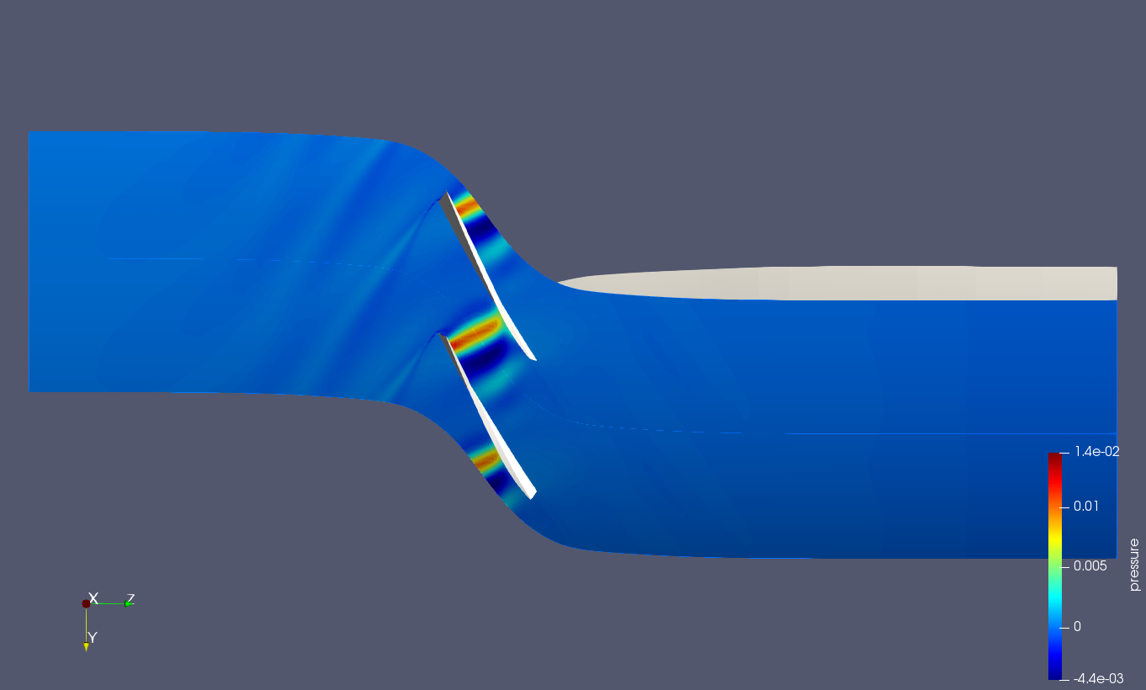
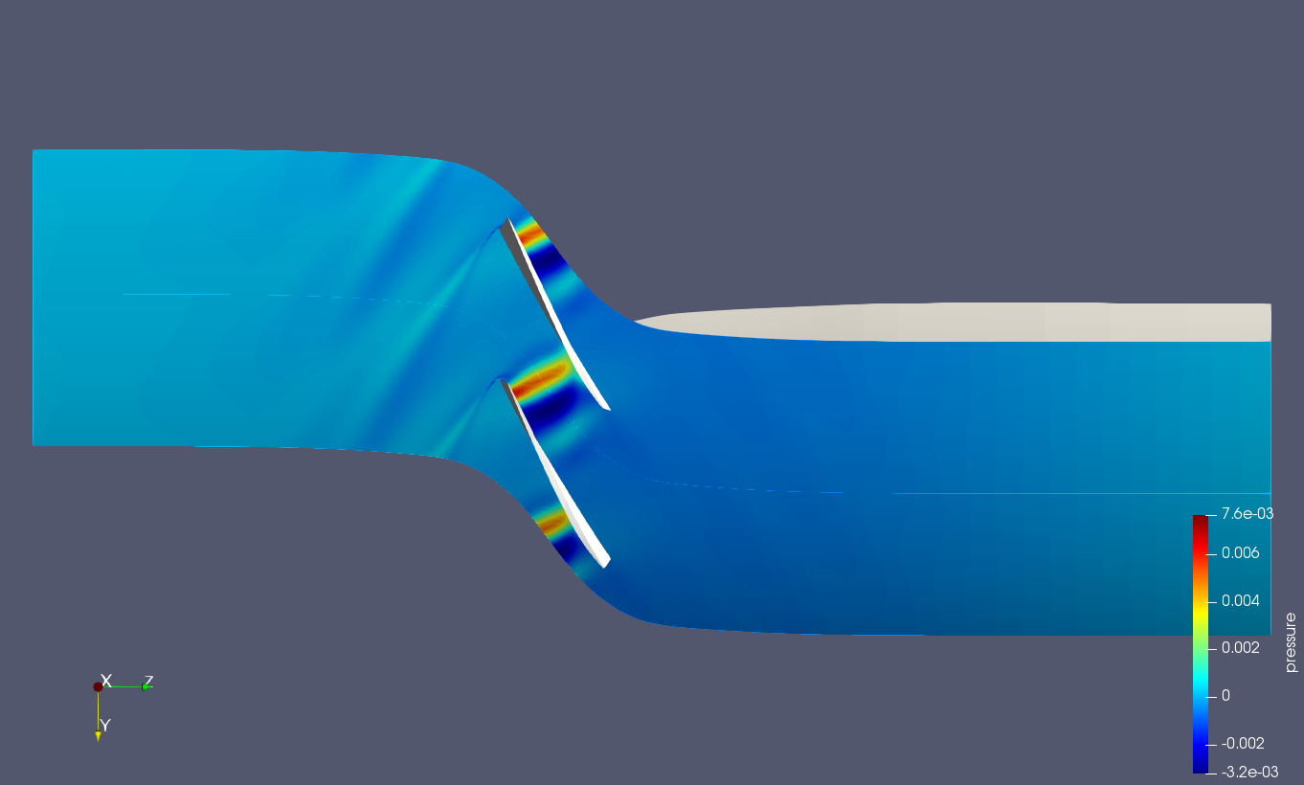
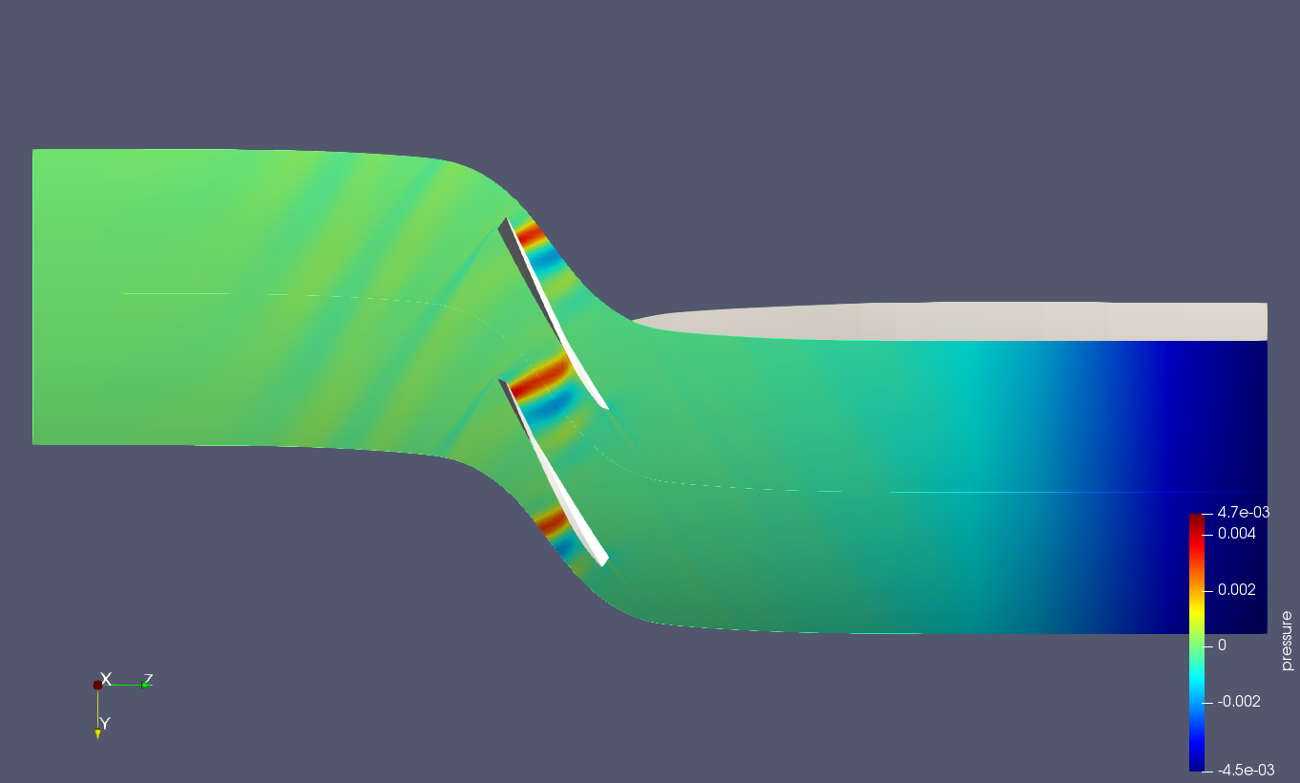
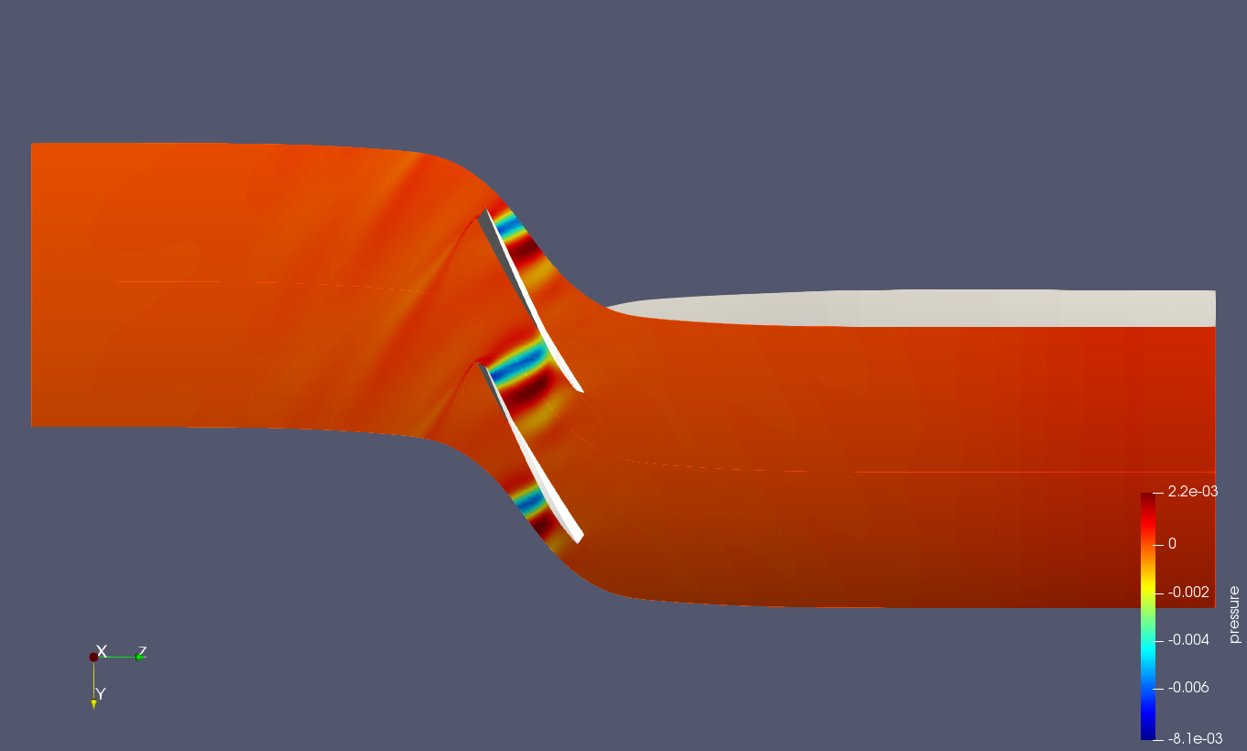





The eigenvectors

Slide 41




















6
real
imag
5
real
imag
9
10
real
imag
2
real
imag
real
imag
6
5
9
8
10
real
imag
8
3
1
real
imag
real
imag
7
4
7
4
real
imag
real
imag

Slide 42
Numerical stall boundary
23kpa
22kpa
21kpa
20kpa

Slide 43



Slide 44


flow field for back pressure of 23kpa
shock
shock

Slide 45


Tip leakage
flow

Slide 47


Look up
from hub
Look down
from tip

Slide 48


Look up
from hub
Look down
from tip

